Slide 1
WELCOME TO THE 2019-20 SCHOOL YEAR
RH ALTERNATIVE HIGH SCHOOL –
THE COMMUNITY WE BELONG TO

Slide 2
Why are you here?

Slide 3
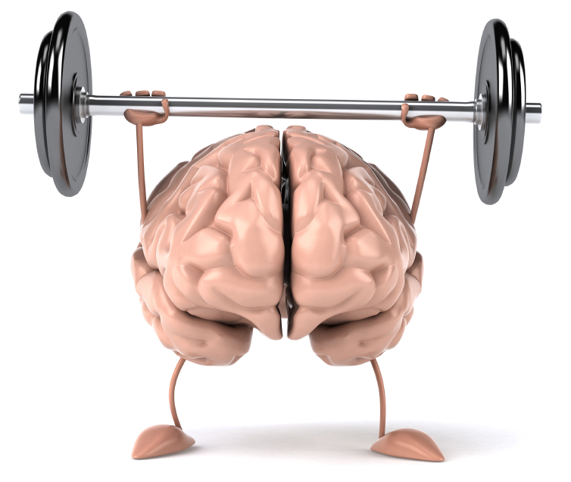
How can you prepare?
Control
Challenge
Commitment
MENTAL TOUGHNESS

Slide 4
“KEYS TO SUCCESS” HOW TO PERSEVERE
CHALLENGE
In your mind view challenges (difficult classwork, tests, social drama) as a game… Challenge yourself to do better or see success.
COMMITMENT
Develop good habits
BE AN EVERY DAY-ER
Give 100% all the time
CONTROL
Establish structure and routines (time, place)
Communicate
Seek extra help
Get involved in school
Notes:
Attendance, Agendas, Lockers…

Slide 5
How can we help?
ALT HIGH EXPECTATIONS & PBIS

Slide 6
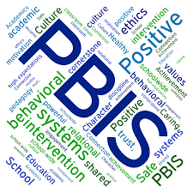
WHAT IS PBIS?
P
Positive
Behavior
Interventions
&
Supports
B
I
S
PBIS works by identifying, monitoring, teaching, and reinforcing district wide expectations.

Slide 7
THE ESSENTIAL BEHAVIORS OF PBIS
→Be Respectful
→Be Responsible
→Be Ready to Learn
→Be Caring and Trustworthy
→Practice Responsible Digital Citizenship

Slide 8
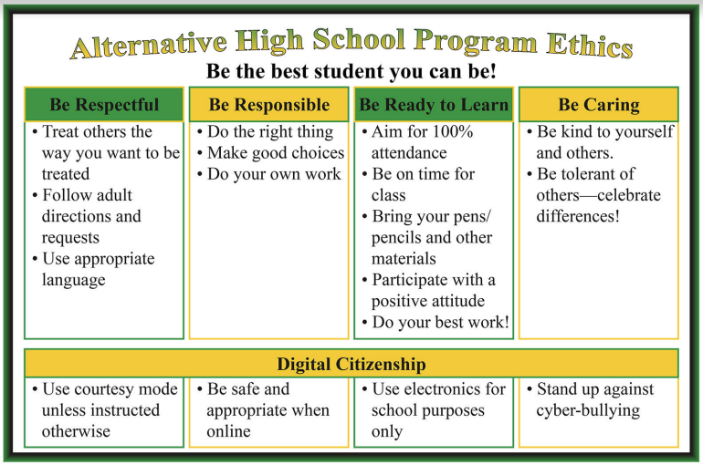
PBIS MATRIX

Slide 9
WHY DO WE USE PBIS?
PBIS is our guide to help us be
MENTALLY TOUGH
We want to create a safe, caring learning environment. Five important behaviors will help us to do this. Every school has implemented the same expectations.
In every school, a positive learning environment is necessary to reach your educational potential.
Our main goal is... GRADUATION!

Slide 10
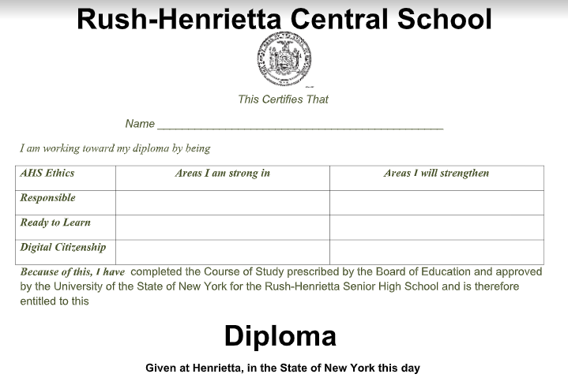
Diploma

Slide 11
OUR FOCUS FOR 2019-2020
Remember: Challenge, Commitment, and Control
Responsible
Ready to Learn, and
Practice Digital Citizenship
will help you achieve those.

Slide 12
ALT High Expectations
to help you succeed

Slide 13
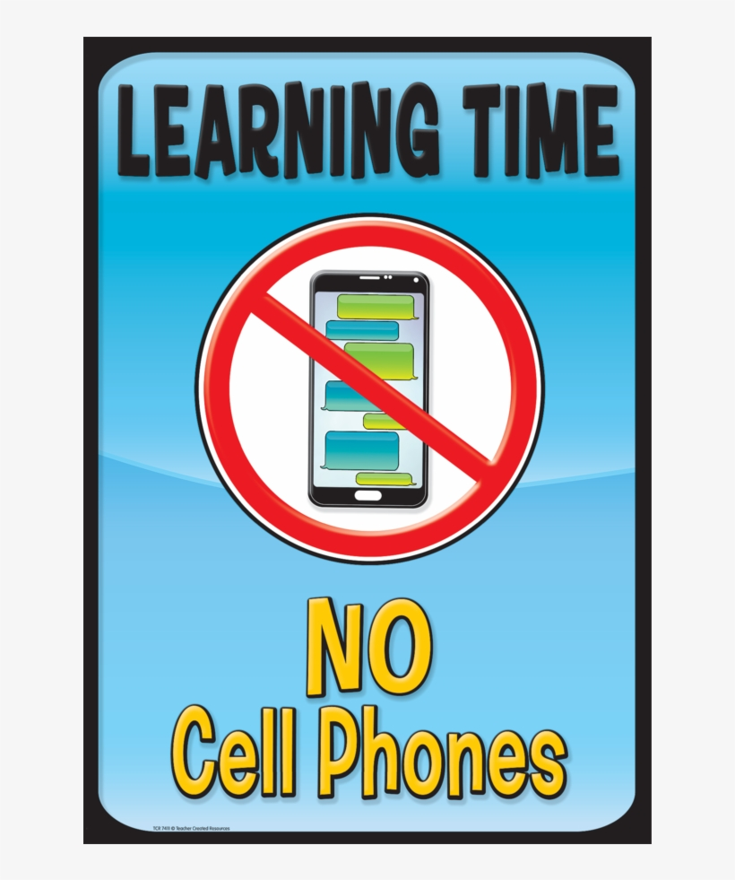

Slide 14
What does this mean?
It means go to CLASS
All of these places need a pass:
Bathroom
Counselors Office
Nurses Office
Main Office

Slide 15
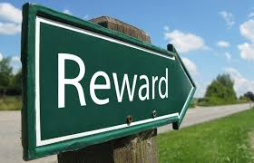
PBIS Activities
-Shout Outs at Monday Meeting
- PBIS Student of the Week
-Community Activities (holiday parties, lunch on us, etc.)
-Community Service Opportunities
- Honor Roll Recognition, Awards, etc.
- Birthday board/Photo contests

Slide 16
WE NEED YOU!
Are you interested in taking an active role in this community? Would you like to help plan the PBIS activities this year?
If so, please feel free to speak with any staff member! We gladly welcome student involvement in the program!

Slide 17
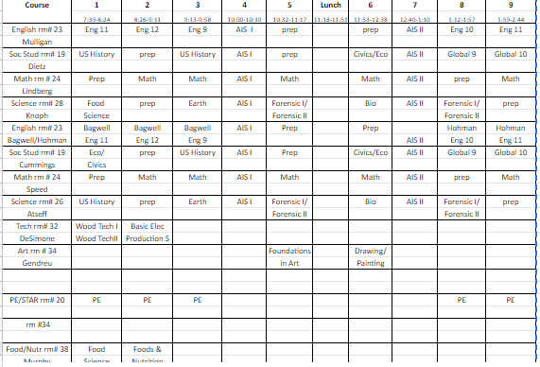

Slide 18
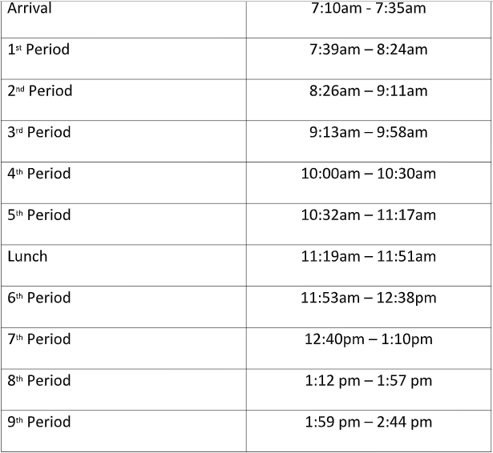

Slide 19
CHROME BOOK INFORMATION
Remember the Essential PBIS Behaviors
Respect, Responsibility, Ready to Learn, Caring and Trustworthy
Practice Digital Citizenship
Signing out Chromebooks
Insurance
Turning in your Chromebooks at the end of the day
Notes:
Have a great start to your year. Remind about the times for the day.

Slide 20
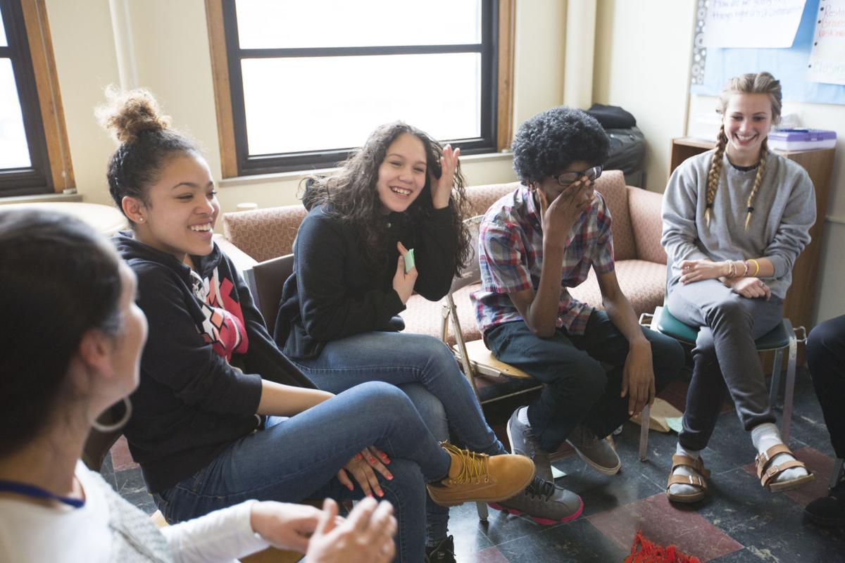
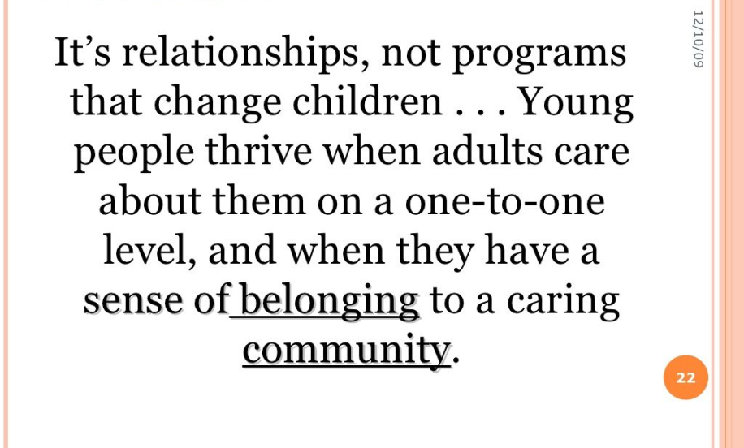
COMMUNITY BUILDING CIRCLES

Slide 21
THE COMMUNITY WE BELONG TO!

