Slide 1
Station 1: Evaluate Each Expression
1. Evaluate for x = -2 and y = 3
2. Evaluate for x = -2 and y = 3
3. Evaluate for x = -2 and y = 3
4. Evaluate for x = -2 and y = 3

Slide 2
Station 2: Combining Like Terms
1.
2.
3.
4.

Slide 3
Station 3: Distributive Property
1.
2.
3.
4.

Slide 4
Station 4: Name the Property
1.
2.
3.
4.

Slide 5
Station 5: Arrangements
1. How many 4-letter words can be formed from the letters in the word POSTER?
2. How many 6-letter words can be formed from the letters in the word FORSAKING?
3. How many 3-letter words can be formed from the letters in the word BEAUTY?
4. How many 5-letter words can be formed from the letters in the word THOUSAND?

Slide 6
Station 6: Simple Probability
Sherry rolls a six sided die with the numbers
1-6 on the faces of the die.
1. P(even number)
2. P(prime number)
3. P(multiple of 3)
4. P(number less than 5)

Slide 7
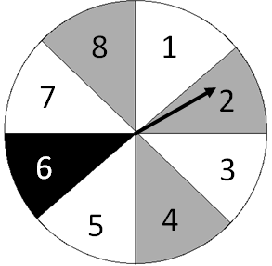
Station 7: Compound Probability
Use the spinner to find the following probabilities
1. P(prime number or black)
2. P(even number or grey)
3. P(number greater than 4
or a multiple of 2)
4. P(multiple of 3 or not white)

Slide 8
Station 8: Compound Probability
Barry has a bag containing 7 blue chips, 5 red chips and 3 yellow chips
1. P(yellow and then blue) w/o replacement
2. P(red and then red) w/o replacement
3. P(blue and then red) with replacement
4. P(yellow and then yellow) with replacement

Slide 9
Station 1: ANSWERS
1.
2.
3.
4.

Slide 10
Station 2: ANSWERS
1.
2.
3.
4.

Slide 11
Station 3: ANSWERS
1.
2.
3.
4.

Slide 12
Station 4: ANSWERS
1.
2.
3.
4.

Slide 13
Station 5: ANSWERS
1.
2.
3.
4.

Slide 14
Station 6: ANSWERS
1.
2.
3.
4.

Slide 15
Station 7: ANSWERS
1.
2.
3.
4.

Slide 16
Station 8: ANSWERS
1.
2.
3.
4.

