Slide 1
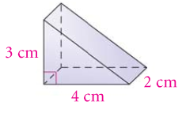
36 cm²
Find the surface area.

Slide 2
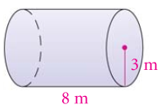
72 m³
Find the volume in terms of .

Slide 3
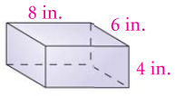
208 in²
Find the Surface Area.

Slide 4
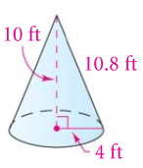
Find the Surface Area to the nearest tenth.
186.0 ft²

Slide 5
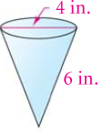
Find the Volume to the nearest tenth.
23.7 in³

Slide 6
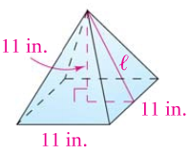
Find the Lateral Area to the nearest tenth.
270.6 ft²

Slide 7
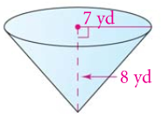
Find the Lateral Area to the nearest tenth.
233.8 yd²

Slide 8
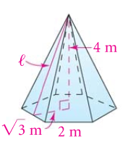
Find the Volume of the hexagonal pyramid to the nearest tenth.
13.9 m³

Slide 9
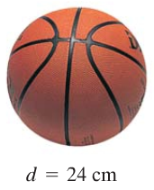
Find the Surface Area in terms of .
576 cm²

Slide 10
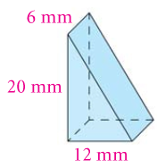
Find the Volume.
720 mm³

Slide 11
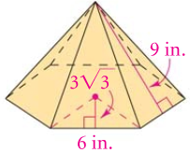
Find the Surface Area of the hexagonal pyramid to the nearest whole number.
256 in²

Slide 12
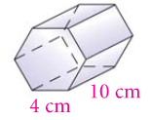
Find the Lateral Area of the hexagonal prism with apothem cm.
240 cm²

Slide 13
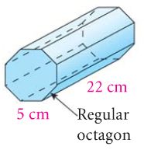
Find the Volume of the octagonal prism with apothem 6 cm.
2640 cm³

Slide 14
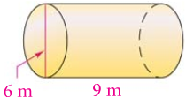
Find the Lateral Area in terms of .
54 m²

Slide 15
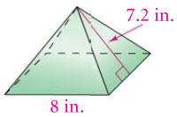
Find the Volume of the square pyramid to the nearest tenth.
127.7 in³

Slide 16
20 cm

Slide 17
21.2 cm

Slide 18
604.4 in³

Slide 19
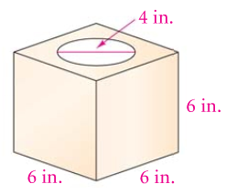
A cylinder has been cut out of the cube. Find the Volume of the remaining solid. Round your answer to the nearest tenth.
140.6 in³

Slide 20
4 gallons
150 ft². How many gallons of paint do you need to paint the walls and ceiling of the bedroom?

Slide 21
102.9 in³

Slide 22
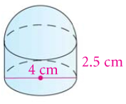
Find the Surface Area in terms of 
22 cm²

Slide 23
6 in.

Slide 24
8.6 in³

