Slide 1
Extreme Dramatic Contrast for Effect
(Chiaroscuro)

Slide 2
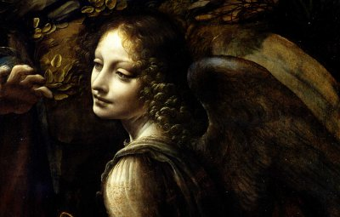
Chiaroscuro was first used during the Renaissance to create drama
Leonardo da Vinci

Slide 3
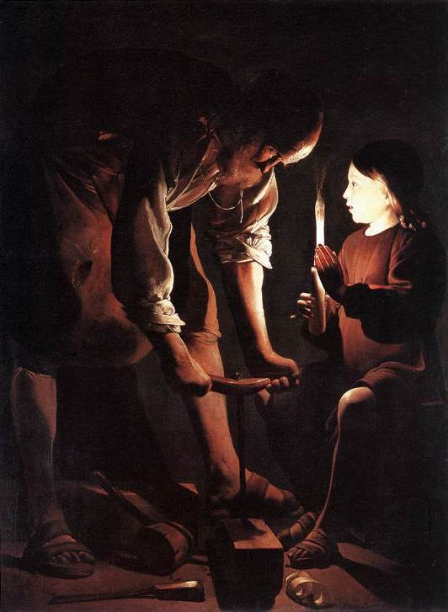
George de la Tour

Slide 4
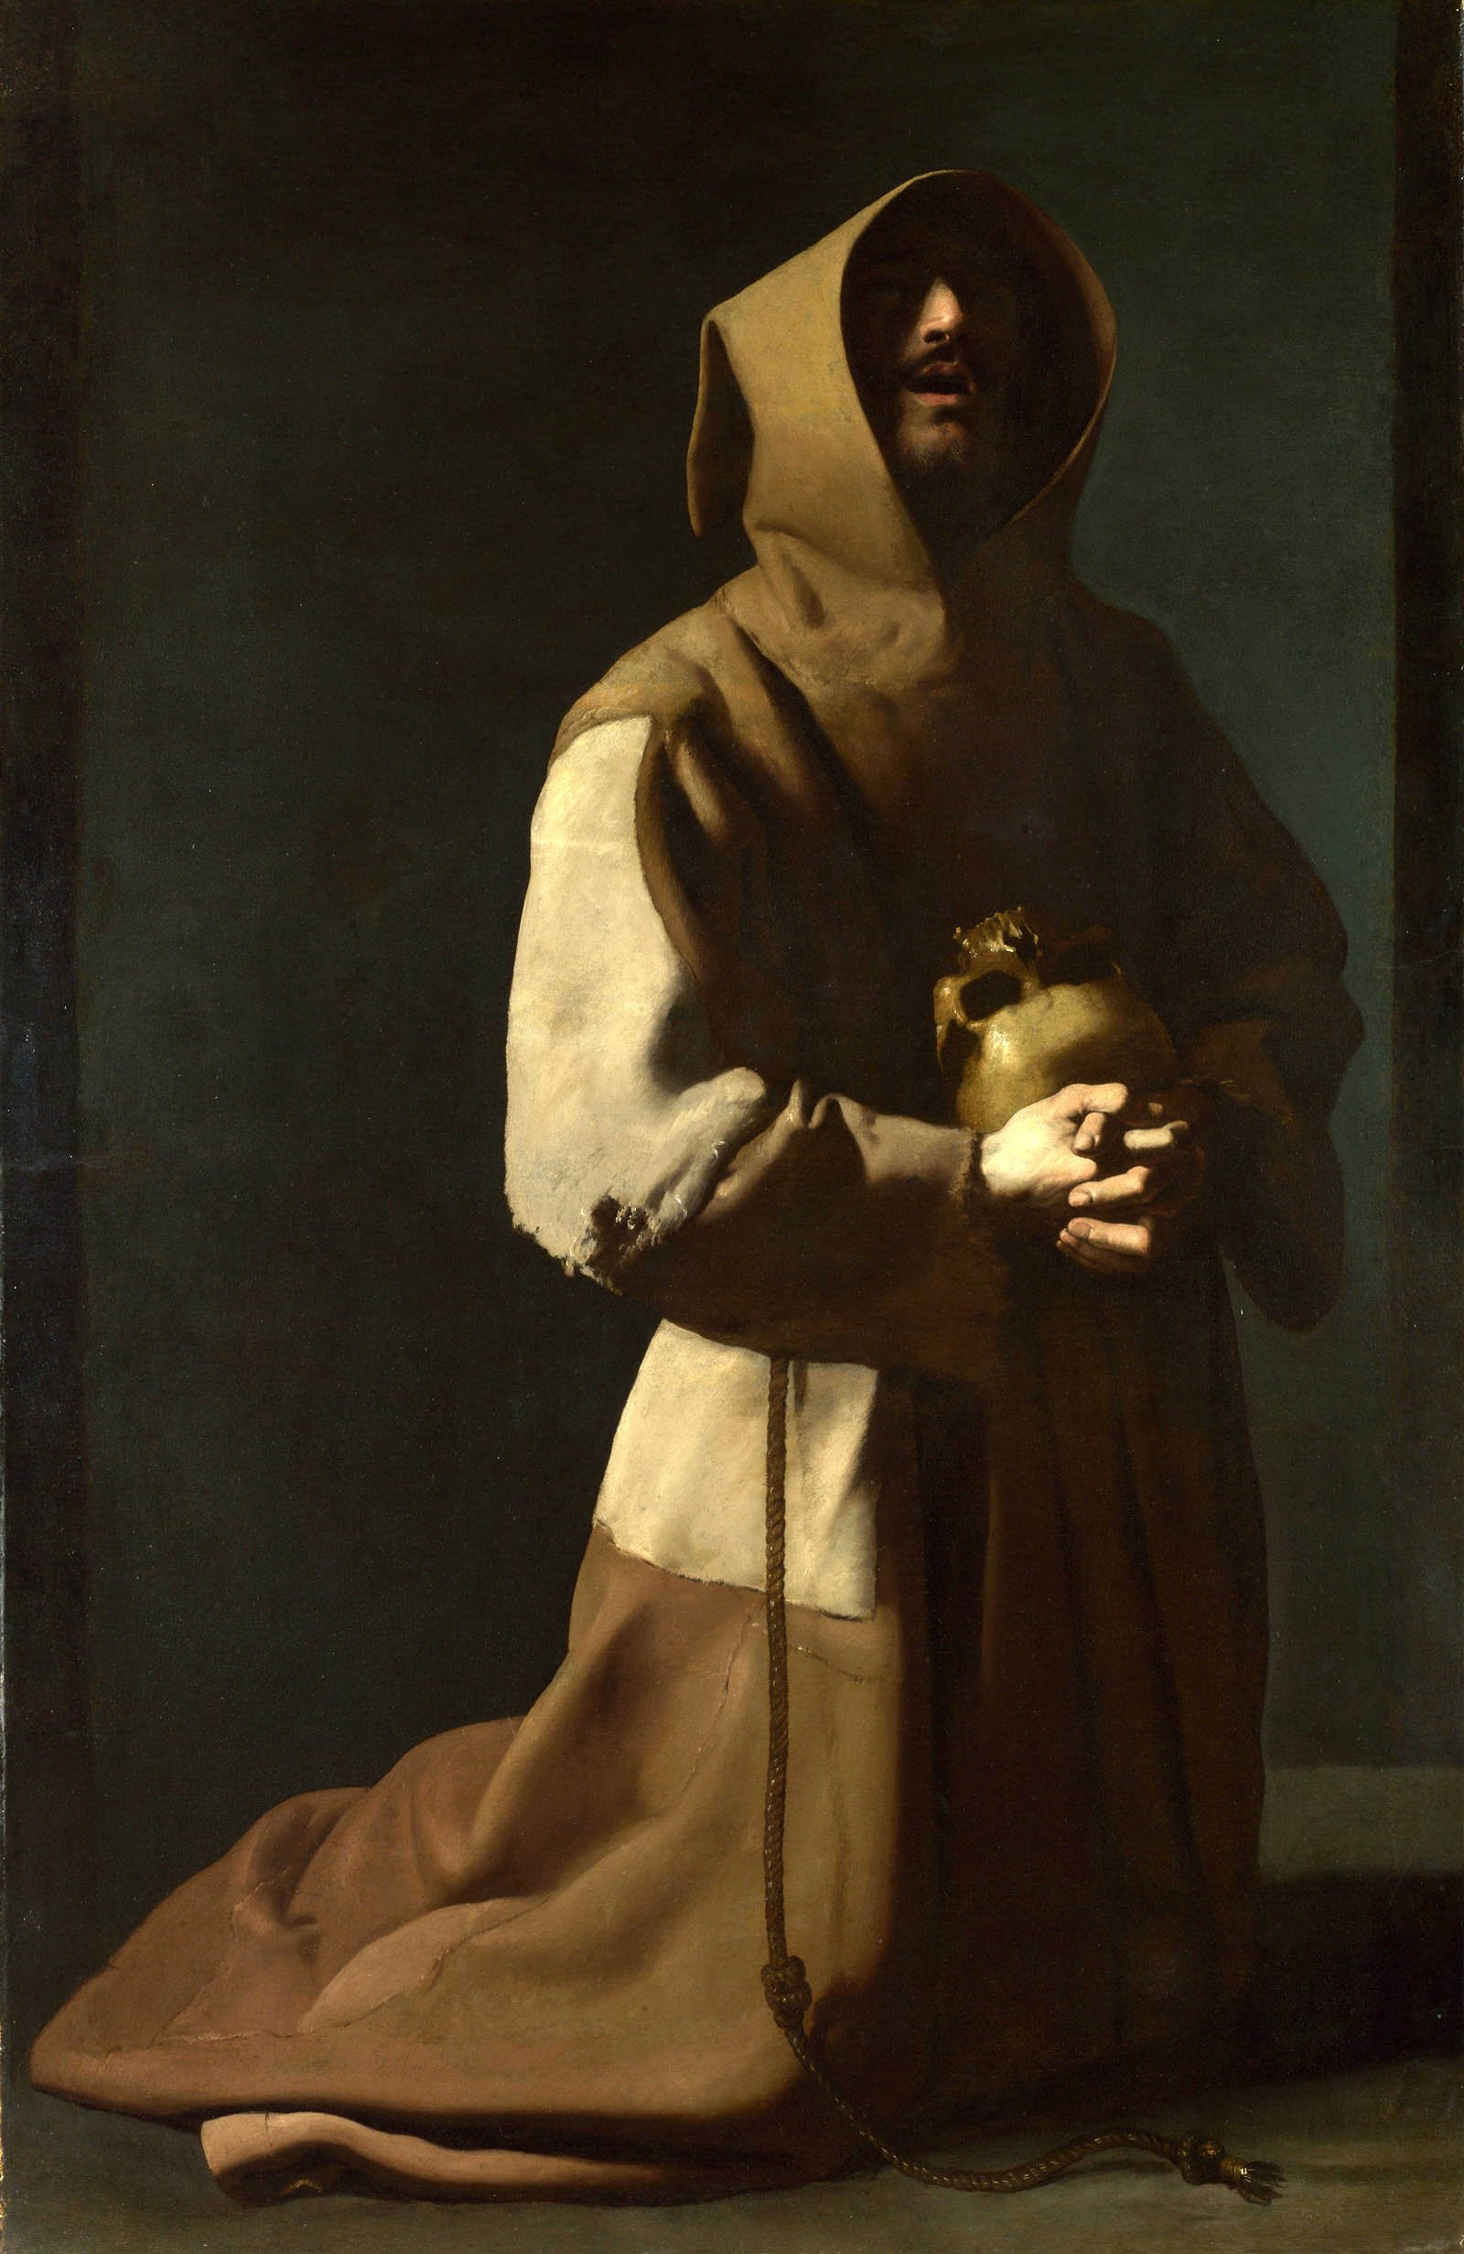
Francisco de Zurbaran

Slide 5
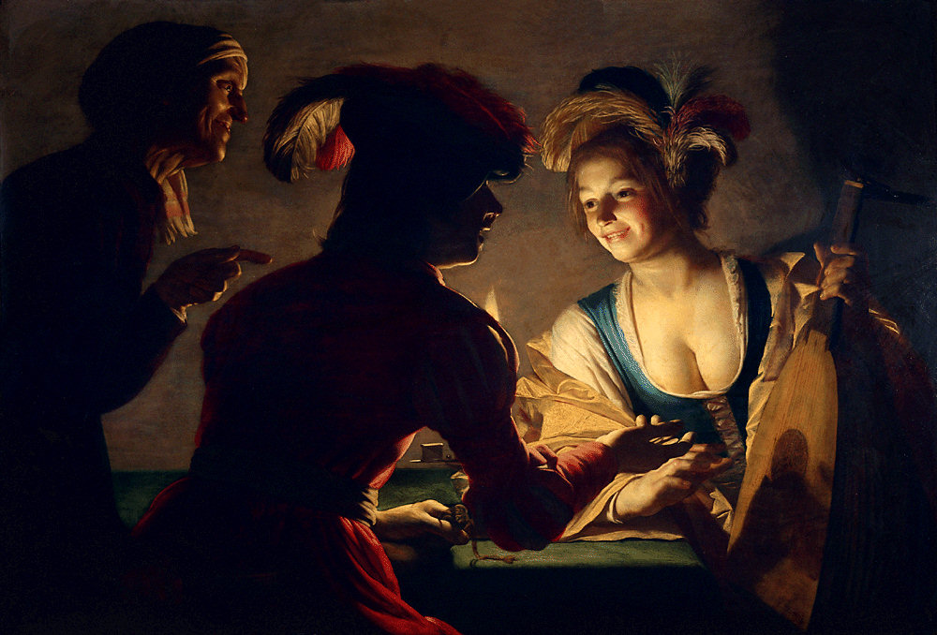
Gerrit van Honthorst

Slide 6
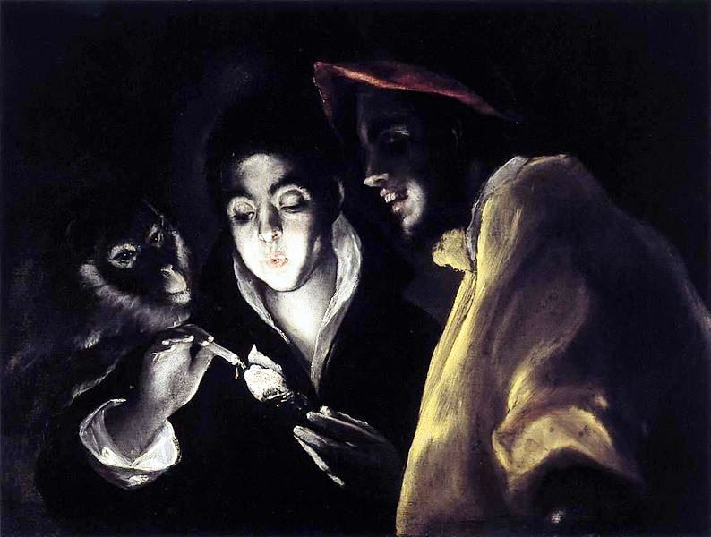
El Greco

Slide 7
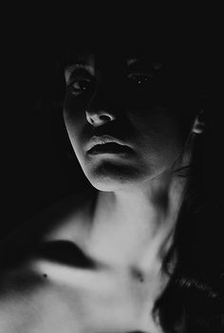
Dramatic Lighting can create mood through unusual directional lighting

Slide 8
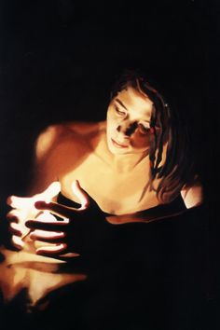
Chiaroscuro can be created with a variety of media including photography….

Slide 9
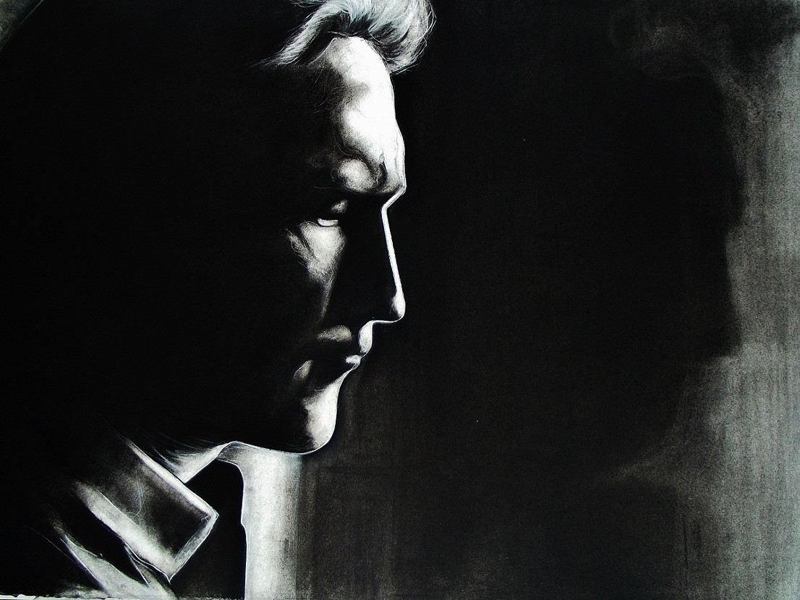
Graphite…

Slide 10
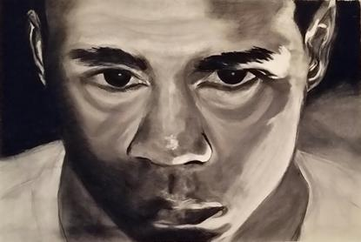
Ink Wash…

Slide 11
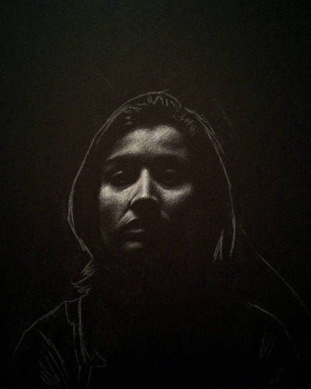
Colored pencil on a black ground

Slide 12
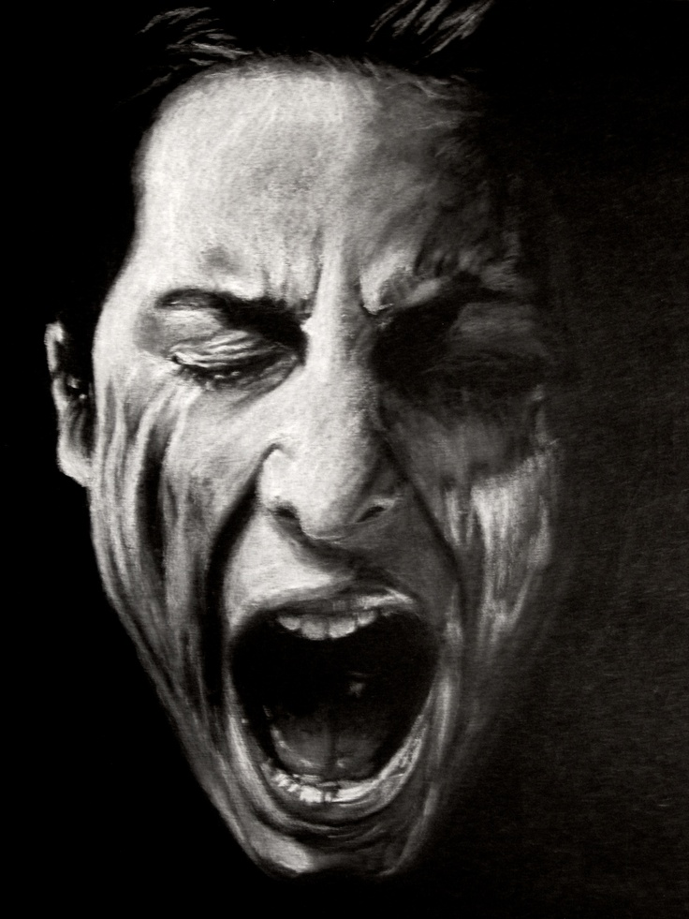
Charcoal…

Slide 13
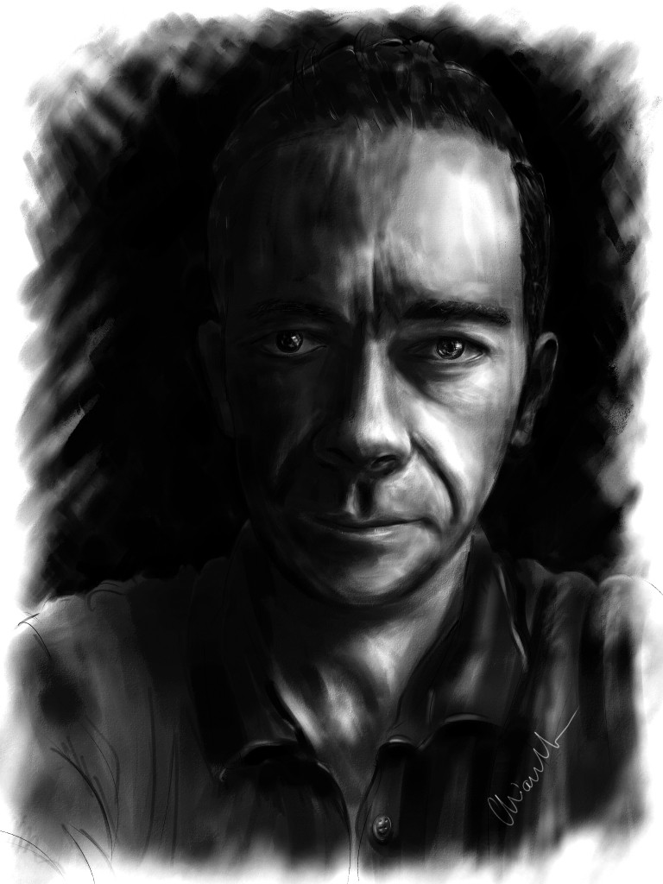
Digital painting…

Slide 14
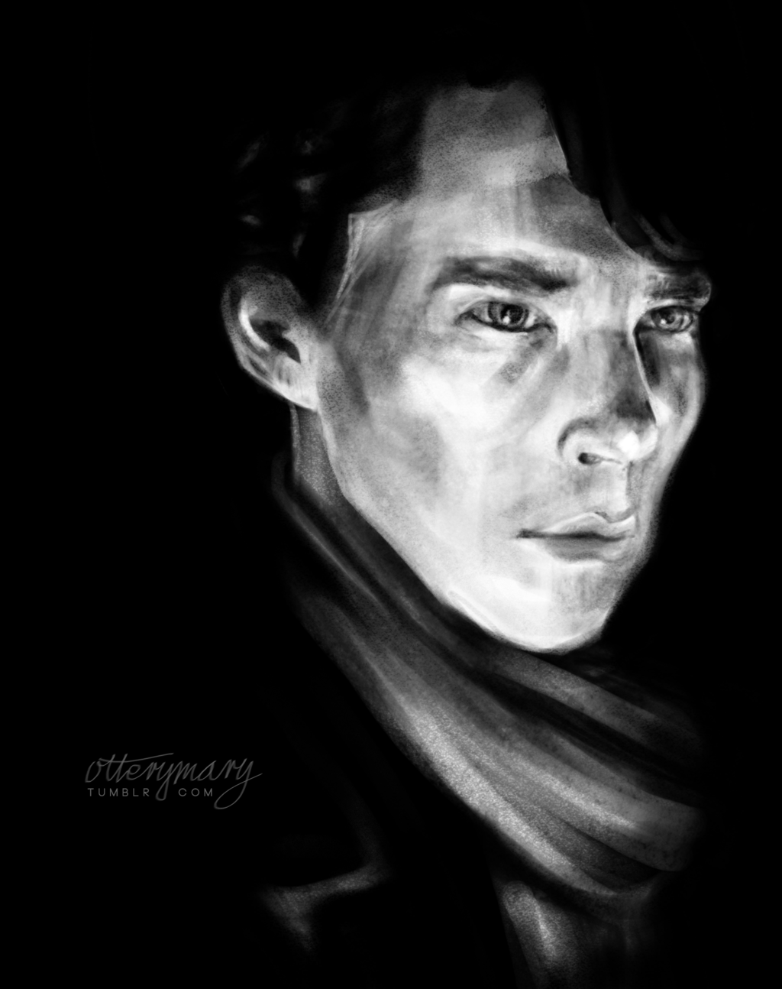
Different emotions can be produced by careful selection of highlighted areas

Slide 15
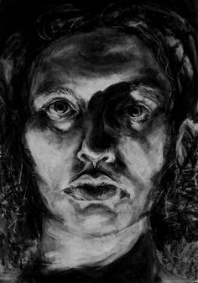
Mood can also be produced through Expressive use of Texture

Slide 16
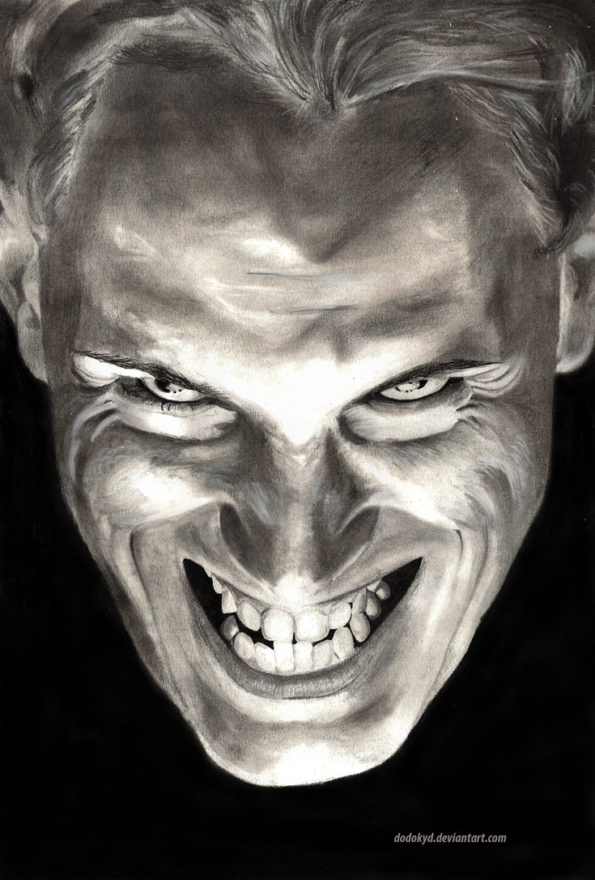
More contrast can mean more drama

Slide 17
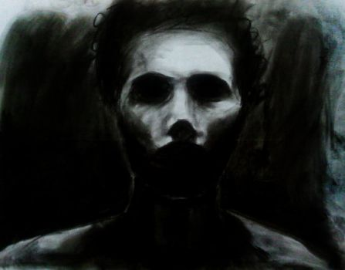
And Sometimes less is MORE

Slide 18
Your mission…
Create a charcoal surface using vine charcoal- smooth and consistent- for use in a reductive drawing. Cover it with newsprint to prevent smudging.
Next class, Dress for a high contrast photo session. Remember- color is not a factor. Think bright accents and texture.

