Slide 1
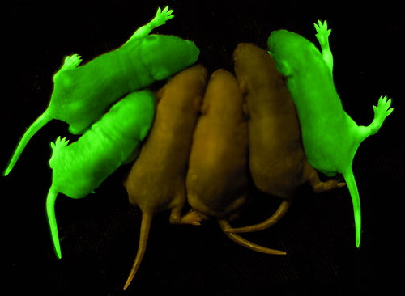
Scientists used a bioluminescent gene from a jellyfish to create “glowing” green mice! Cool huh? Check out this PowerPoint to see how they did it and more!

Slide 2
Genetic Engineering
Taking DNA from one organism and inserting it into the DNA of another organism to ensure the organism will have a specific trait
It produces an organism that has a new trait it would most likely not have developed on its own
Example: If we take a gene for bioluminescence from a jellyfish and put it into a mouse’s DNA, we will get a mouse that can “glow” under UV light

Slide 3
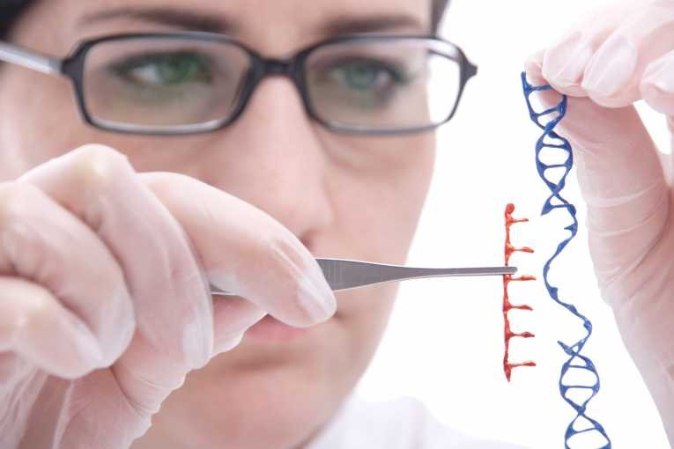
Genetic Engineering
Involves the direct manipulation of genes
Scientists “cut and paste” DNA of one organism into another

Slide 4
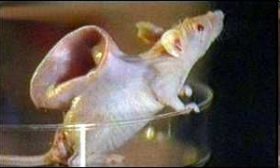
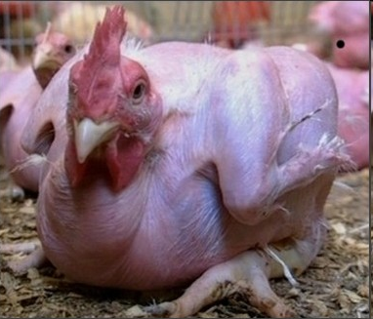
Scientists genetically engineered a mouse to grow a human ear by inserting human genes into a mouse embyro’s DNA! Whoa!
But that’s not all!
Scientists also engineered chickens to be featherless by REMOVING the gene in chicken DNA that causes them to grow feathers!

Slide 5
Remember!
Genetic engineering involves the direct manipulation of genes!

Slide 6
Selective Breeding
Mating organisms with “desirable” traits to get offspring with the desirable traits of both parents
Example: If you want red, curly haired puppies you would mate a red haired dog and a curly haired dog
Selective breeding is used for dogs, cats, other pets, cattle, and crops.

Slide 7
Remember!
Selective breeding:
involves sexual reproduction!
crosses organisms with desirable traits to produce offspring that have the traits from both parents!

Slide 8
So how are they different?
Genetic Engineering
Relatively new process performed within labs
Manipulates or alters the genetic makeup of organisms
Results in organisms with new traits
Selective Breeding
Process has been around for thousands of years
Combines the best traits of two organisms
Results in organisms that have the desirable traits of their parents

Slide 9
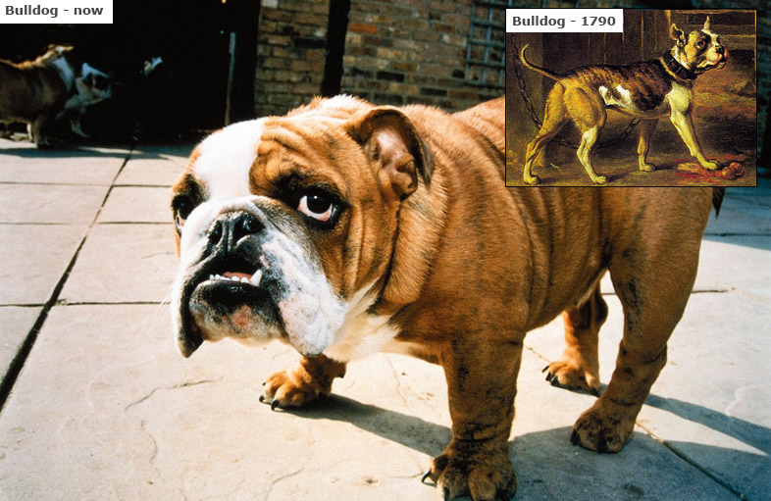
How are they alike?
Both involve human preference for a particular trait

