Slide 1
Welcome to College & Career Readiness Night
Tonight’s Speakers:
Patricia Prinzi, School Counselor (A-K)
pprinzi@rhnet.org 359-5572
Rozetta Smith, School Counselor (L-Z)
rozsmith@rhnet.org 359-5573
Kerry Macko, NGA Principal
kmacko@rhnet.org 395-5558

Slide 2
Tonight’s Agenda
Taking the Temperature
Graduation Requirements/ Transcript
Career & College Pathways & Readiness
Growth Mindset
Wholehearted Parenting
Naviance Family Connection Program & Course Selection Process
RH Opportunities/College Preparation
Next Steps & Deadlines
Questions & Responses

Slide 3
Taking The Temperature

Slide 4
Graduation Requirements

Slide 5
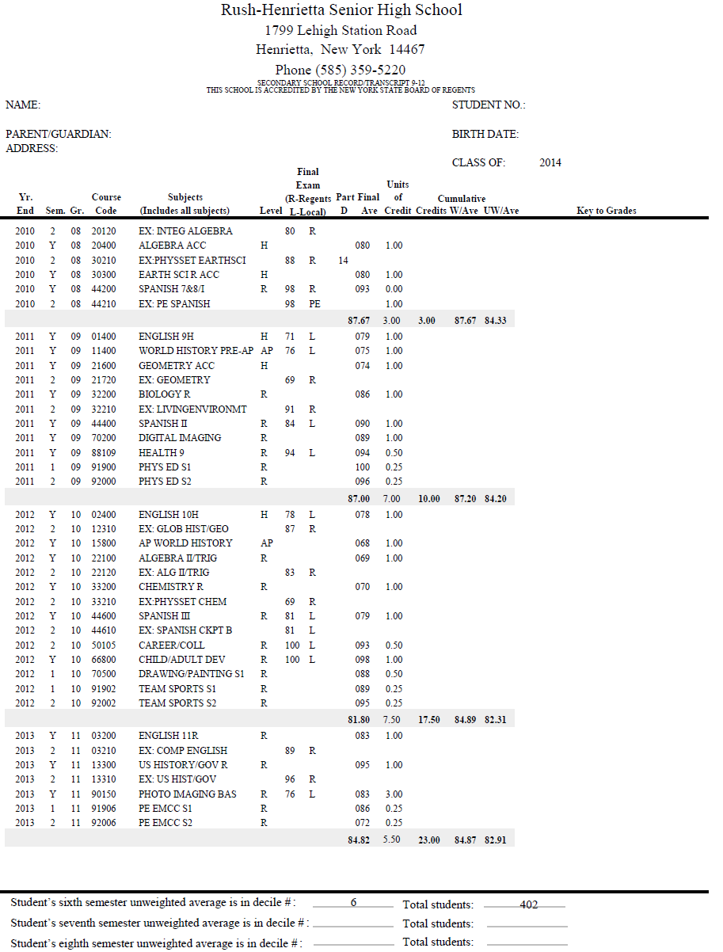
Notes:
transcript

Slide 6
What do you want to do after high school?
Who Am I?
2. Where do I want to go?
Interests, Skills & Values
What do I like and dislike? (Interests)
What do I do well? (Skills)
What will make me happy in a job? (Values)
Careers?
Life After High School
There are many options – apprenticeships, career/technical schools, employment, military opportunities, colleges and universities. It’s important to choose an option that fits you.
3. How will I get there?
Academic Plan (Classes)
All good roads to your future go through high school.

Slide 7
Which path will you choose?
High School
You Are Here
4 years
Vocational School/
Apprenticeship
2-3 years
Work
Or
On the job training
College/
University
Bachelor’s Degree
4 years
Community College
Associate’s Degree
2 years
Military
University
Graduate Degree (Master’s, PhD, MD)
1-4 years
CAREER

Slide 8
What does it mean to be “College and Career Ready”?
Career: Students work in an environment where there is opportunity for advancement. They have the flexibility of thinking and ability to adapt, to change jobs and learn new skills.
College: Students can enter a 2 or 4 year school and not just be admitted but be retained, be successful without remedial courses, and graduate on time.

Slide 9
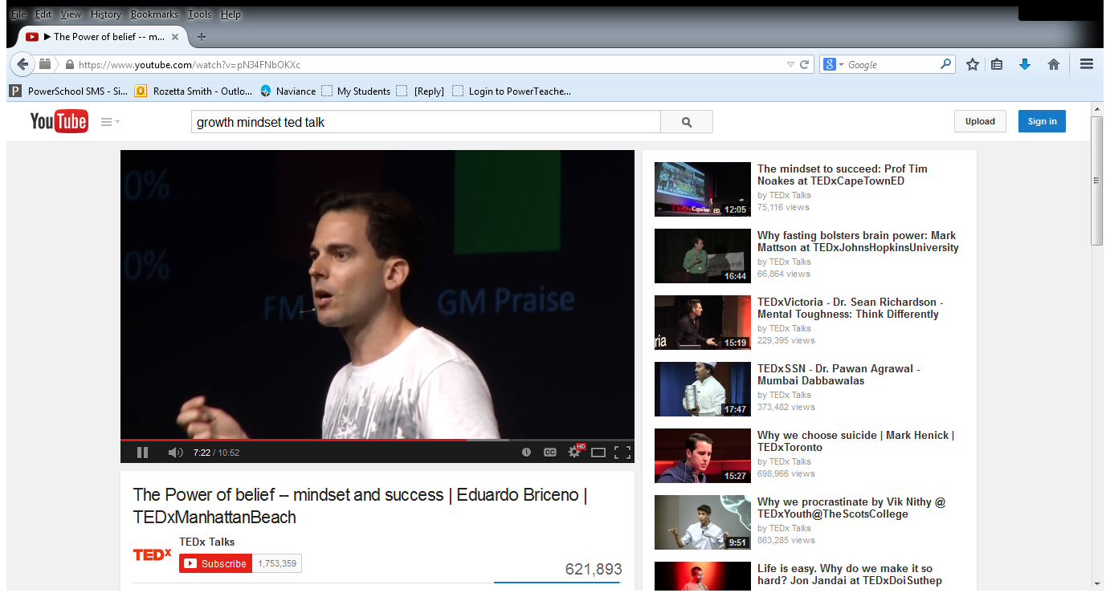
Growth Mindset

Slide 10
Whole-Hearted Parenting
We cannot give our children what we do not have
Honor hard work and perseverance above achievement
Normalize discomfort

Slide 11
Naviance Process

Slide 12
Learning Opportunities Available in
Rush-Henrietta

Slide 15
What Do Colleges Look At?
Academic Record
Course Selection
Rank in Class
Standardized Test Scores
Extracurricular Activities
Recommendation Letters
College Essay
College Interview
The Application Itself

Slide 16
Next Steps
Scheduling information, including a course description book and “how to” instructions for using Naviance Family Connection will be mailed home in early December. Classroom presentations will take place from December 4th until December 17th.
All NGA students will be assigned a date and time to individually meet with their counselors for a scheduling appointment. These appointments will occur during PE classes only. All students will be given a pass notifying them of their appointment several days in advance. Individual scheduling meetings will begin on January 5th and must be completed by February 13th.
If you would like to attend your student’s appointment either in person or via phone, please contact the NGA Counseling Office after December 15th at (585) 359-5570 for the date and time that has been assigned to your student.

Slide 17
DEADLINE:
Changes to course selections can be made until March 7, 2015.
Requests for changes WILL NOT be honored after March 7, 2015.

Slide 18
Questions and Responses

Slide 19
How Did We Do?

Slide 20
Additional Resources
Classroom pages: http://www.rhnet.org/webpages/pprinzi/
http://www.rhnet.org/webpages/rsmith/
SUNY page: http://www.suny.edu/
College Board: http://www.collegeboard.org/

