Slide 1
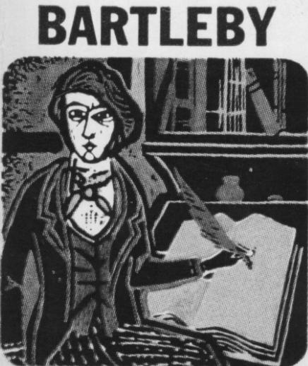
Argumentative Essay

Slide 2
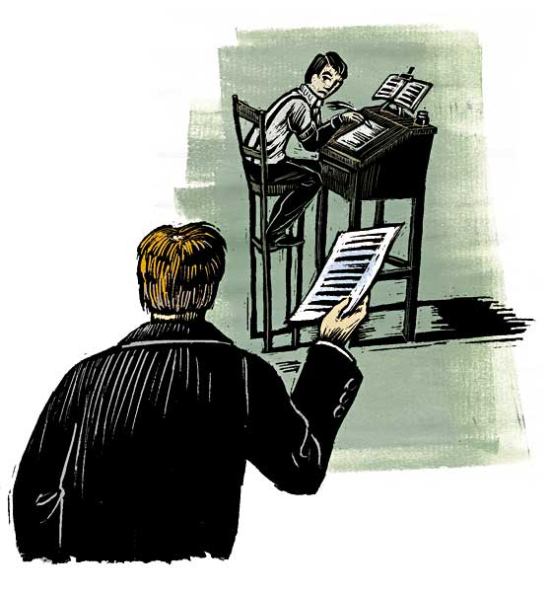
Constructing the Introduction
Declare Your Thesis !!!

Slide 3
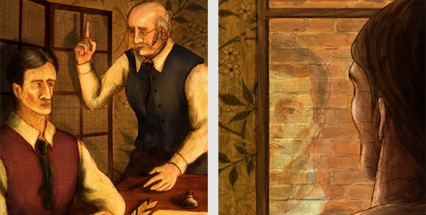
Student Sample Introduction
Bartleby’s views of the world are influenced by his existential nihilistic and stoic beliefs. When he can no longer endure the pain of living a purposeless life, Bartleby begins to exhibit stoicism as he attempts to rid himself of suffering.

Slide 4
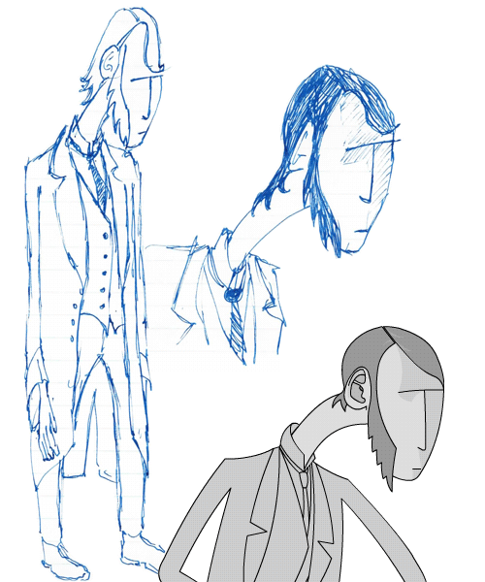
Student Sample Introduction
Bartelby’s world view is influenced through his life experiences. As events and people continue to let him down, Bartelby’s outlook on life becomes increasingly forlorn- taking him from existentialism, to existential nihilism, to Stoicism in a matter of weeks.

Slide 5
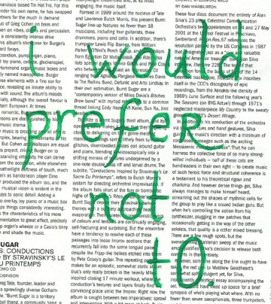
Student Sample Introduction
Following his employment as a scrivener, Bartleby becomes a paragon of Stoicism. His close adherence to Stoic beliefs, and his reaction to those around him, clearly reveals his philosophical outlook.

Slide 6
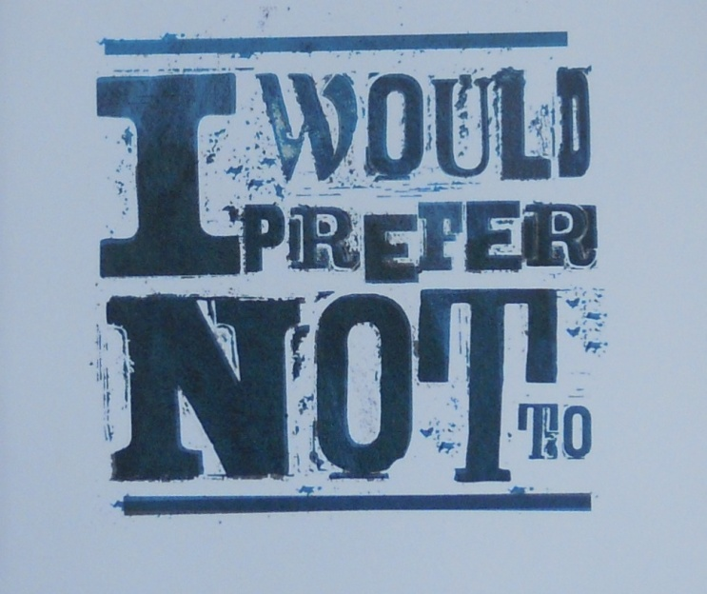
Student Sample Introduction
The actions of Bartelby throughout the novel are ones of an existential nihilist who also exhibits a stoicist persona. His thought of life not being worth living comes from the idea of an existential nihilist, as well as the fact that in order to be happy, one must completely remove the negativity which he did – by ending his life.

Slide 7
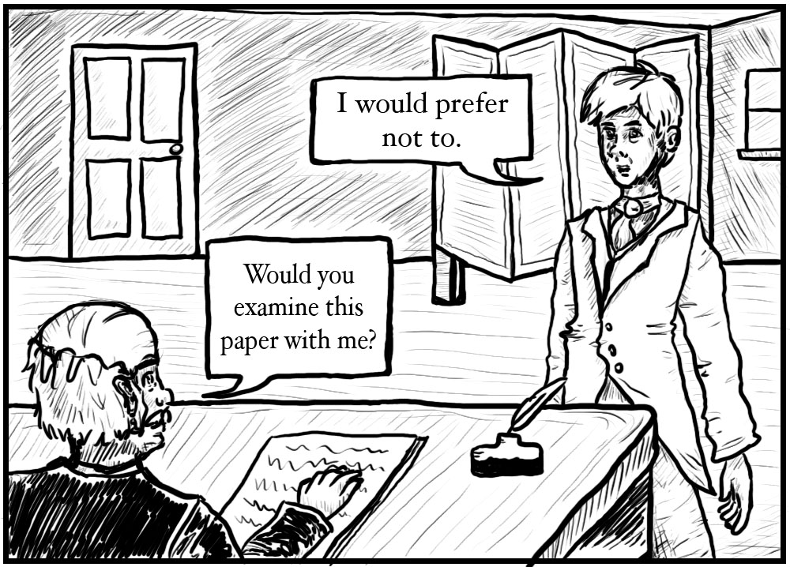
Student Sample
Bartleby’s actions and reactions suggest a nihilistic outlook with stoic undertones. The transformation experienced by Bartleby illustrates how his mind operates.

Slide 8
1st Premise Bank Argue … No Summary
* The Millennials are often looked at as the dumbest generation
* Sometimes Millennials are stereotyped as being lazy and self-centered.
* The Millennials have been called many things.
* The Millenials are facing many problems

Slide 9
1st Premise Bank
The Millennials inherited the wreck that their predecessors left for them.
Social media has become a superficial cornerstone in the shallow lives of Millennials.
Unemployment is at forty-two percent for the Millennials because they lack the work ethic to land decent jobs.
The poor economy is to blame, not technology.
These negative stereotypes are all true.

Slide 10
How To Synthesize
In each paragraph, you need to quote from at least 2 sources !!!

Slide 11
Student Sample Syllogism
Technology is the root cause of our problems. Today with all the new advancements, kids are more focused on keeping up with the media and the lives of others instead of concentrating on finding jobs and looking at colleges to attend. With the popular social media cites, our generation “has never engaged in a cause that required more effort than clicking something” (Straw). Instead of going out and joining clubs, organizations, and recreational groups, our generation would rather sit at home and use their phones or X-Box all day. Any effort that a person needs to exhibit in order to get involved and accepted into a good group is apparently too much for the millennials to handle. They would rather stay inside and use their fingers to scroll and click on a screen as an alternative to being active and interacting with others. More and more [KEEP GOING]

Slide 12
Syllogism Continued
People in our generation would rather stay home and be on technology instead of going into the work force to make money. This greatly supports the idea that “millennials are the first generation not to cite work ethic as one of their top defining characteristics” (Smitherian). This is a major setback in standards as seen from the view point of older generations. These older generations were known for their initiative and work ethic. For them to see our generation focused exclusively on pop culture and music is a “disgrace that has never been seen before” (Smith). Since our generation is not developing and holding onto the old ideals, we will be at risk of not finding employment to social prestige. Our lack of caring and overall stupidity will always brand us as the Dumbest Generation.

Slide 13
What the Syllogism Should Look Like
2nd Premise = Quote From At Least 2 Sources In the Paragraph
1st Premise = An Argument
Conclusion = Analysis of Your Quotes

Slide 14
Another Student Syllogism
1st Premise Must Argue a Point !!!
Embed Your Quotes !!!

