Slide 1
Notes:
Session 18

Slide 2
$100
$100
$100
$100
$100
$200
$200
$200
$200
$200
$300
$300
$300
$300
$300
$400
$400
$400
$400
$400
$500
$500
$500
$500
$500

Slide 3
Are They Similar?

Slide 4
Side-Splitter and More

Slide 5
Finding the Missing Piece

Slide 6
Area and Perimeter

Slide 7
Similarity in Right Triangles

Slide 8
Are they Similar?
Side-Splitter and More
Find the Missing Piece
Area and Perimeter
Right Triangle Similarity
$100
$100
$100
$100
$100
$200
$200
$200
$200
$200
$300
$300
$300
$300
$300
$400
$400
$400
$400
$400
$500
$500
$500
$500
$500

Slide 9
CATEGORY 1 - $100
Determine whether
the pair of polygons
are similar. Justify
your answer.
15
25
6
10

Slide 10
CATEGORY 1 - $200
Are these 2 triangles similar? Justify your answer.
13
5
3
12
4
11

Slide 11
CATEGORY 1 - $300
Complete the following when ∆IJK ~ ∆ LMN .

Slide 12
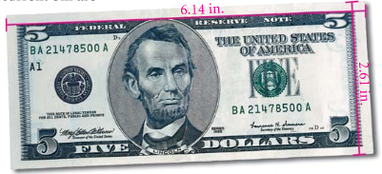
CATEGORY 1 - $400
From 1861 to 1928, U.S currency measured 7.42 in. by 3.13 in. The dimensions of a current bill are shown below. Are the old and new bills similar rectangles?

Slide 13
CATEGORY 1 - $500
A map has dimensions 9 in. by 15 in. You want to reduce the map so that it will fit on a 4 in. by 6 in. index card. What are the dimensions of the largest possible complete map that you can fit on the index card?

Slide 14
CATEGORY 2 - $100
What is the value of x?
x +2
6
21
18

Slide 15
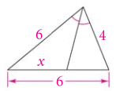
CATEGORY 2 - $200
Solve for x.

Slide 16
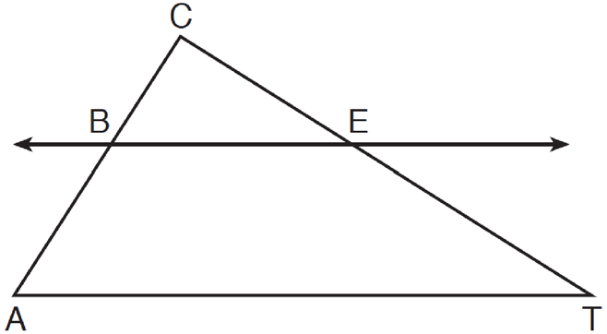
CATEGORY 2 - $300
If CB = 3, CA = 10, and CE = 6, what is the length of ET ?

Slide 17
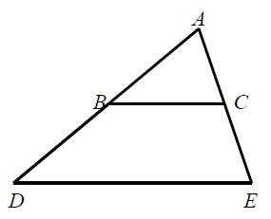
CATEGORY 2 - $400
BC||DE. AB = 7, BC = 8, and
DE = 34. Find BD.

Slide 18
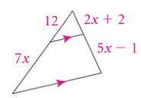
CATEGORY 2 - $500
Solve for x.

Slide 19
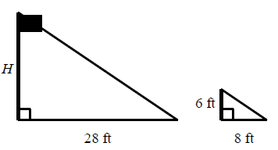
CATEGORY 3 - $100
Solve for H.

Slide 20
CATEGORY 3 - $200

Slide 21
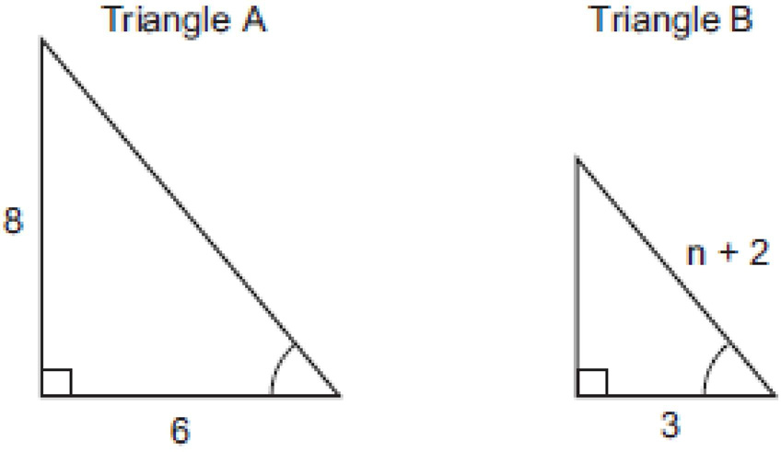
CATEGORY 3 - $300
Solve for x.
3x + 5º
2x + 10º

Slide 22
CATEGORY 3 - $400
Solve for n.

Slide 23
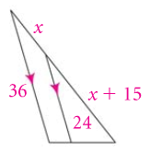
CATEGORY 3 - $500
Solve for x.

Slide 24
CATEGORY 4 - $100
The perimeter of ∆ PQR is 75, PQ = 25, ∆ PQR ~ ∆ STU, and ST = 30. What is the perimeter of
∆ STU?

Slide 25
CATEGORY 4 - $200
The ratio of the corresponding sides of two similar squares is 1 to 3. What is the ratio of the area of the smaller square to the area of the larger square?

Slide 26
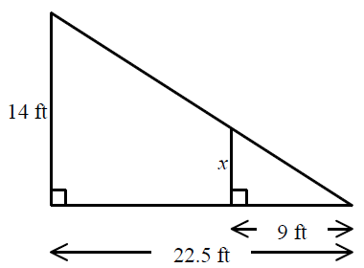
CATEGORY 4 - $300
Find the area of the smaller triangle

Slide 27
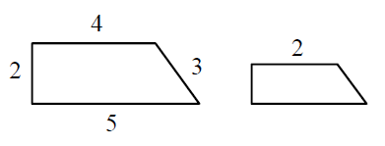
CATEGORY 4 - $400
Below are 2 right trapezoids. Find the area of the smaller trapezoid.

Slide 28
CATEGORY 4 - $500
The perimeters of 2 similar triangles are 12 ft and 45 ft. The area of the smaller triangle is 64ft². What is the area of the larger triangle?

Slide 29
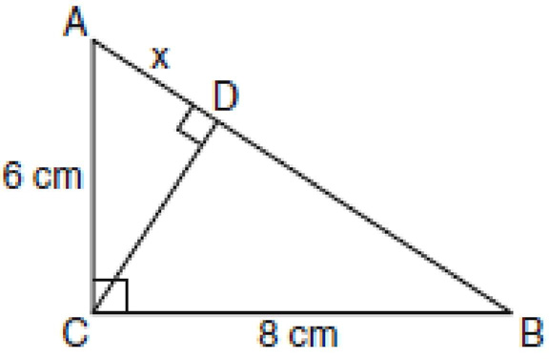
CATEGORY 5 - $100
Solve for x

Slide 30
CATEGORY 5 - $200
Find the geometric mean for the lengths of 9 and 24 in simplest radical form.

Slide 31
CATEGORY 5 - $300
The altitude to the hypotenuse of a right triangle divides the hypotenuse into segments 2 cm and 8 cm long. Find the length of the altitude.

Slide 32
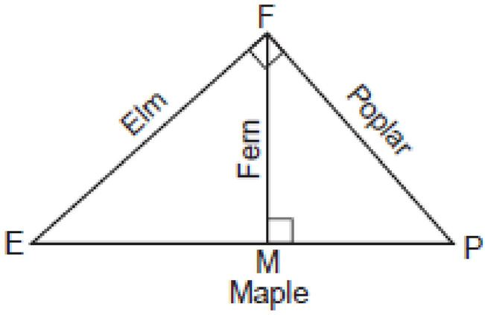
CATEGORY 5 - $400
Four streets in a town are illustrated in the
accompanying diagram. If the distance on Poplar Street from F to P is 12 miles and the distance on Maple Street from E to M is 10 miles, find the distance on Maple Street, in miles, from M to P.

Slide 33
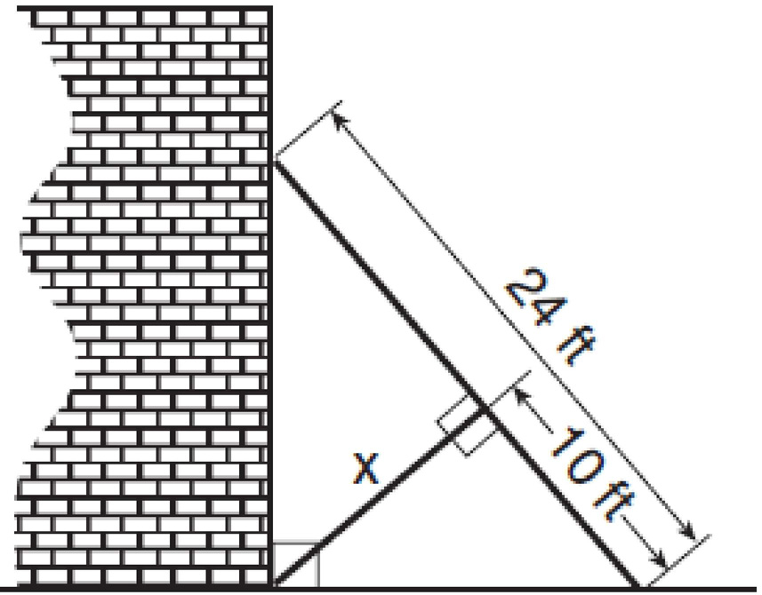
CATEGORY 5 - $500
Solve for x in simplest radical form.

Slide 34
CATEGORY 1 - $100
Yes
Corresponding sides are in proportion.

Slide 35
CATEGORY 1 - $200
No
Corresponding sides are not in proportion.

Slide 36
CATEGORY 1 - $300

Slide 37
CATEGORY 1 - $400
No
Corresponding sides are not in proportion.

Slide 38
CATEGORY 1 - $500
3.6 in. by 6 in.

Slide 39
CATEGORY 2 - $100

Slide 40
CATEGORY 2 - $200

Slide 41
CATEGORY 2 - $300

Slide 42
CATEGORY 2 - $400

Slide 43
CATEGORY 2 - $500

Slide 44
CATEGORY 3 - $100

Slide 45
CATEGORY 3 - $200

Slide 46
CATEGORY 3 - $300

Slide 47
CATEGORY 3 - $400

Slide 48
CATEGORY 3 - $500

Slide 49
CATEGORY 4 - $100
90

Slide 50
CATEGORY 4 - $200
1:9

Slide 51
CATEGORY 4 - $300

Slide 52
CATEGORY 4 - $400

Slide 53
CATEGORY 4 - $500

Slide 54
CATEGORY 5 - $100
3.6

Slide 55
CATEGORY 5 - $200

Slide 56
CATEGORY 5 - $300
4 cm

Slide 57
CATEGORY 5 - $400
8

Slide 58
CATEGORY 5 - $500

Slide 60
Right or Wrong??

Slide 61
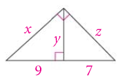
FINAL CATEGORY
Solve for x, y, and z in simplest radical form.

Slide 62
FINAL CATEGORY

Slide 63
END OF GAME
Daily Doubles and
usage notes follow...

