Slide 1
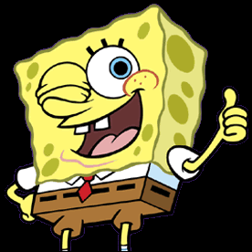
Spongebob Squarepants
Synthesis Essay

Slide 2
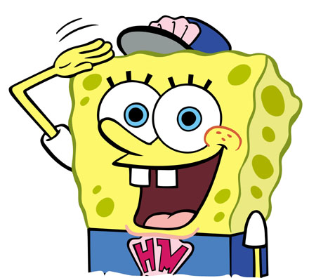
Constructing the Introduction
Declare Your Thesis !!!

Slide 3
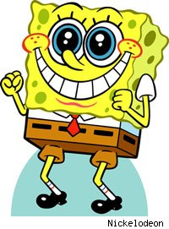
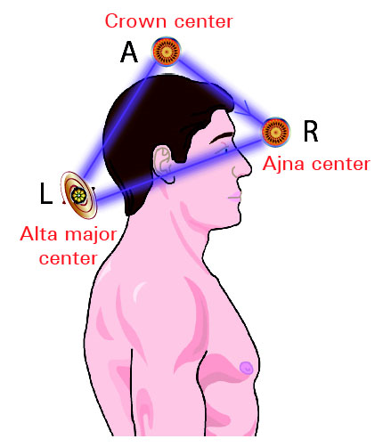
Declare Your Thesis
It’s Not Hip To Be Square !!!
You Have a Triangulated Head

Slide 4
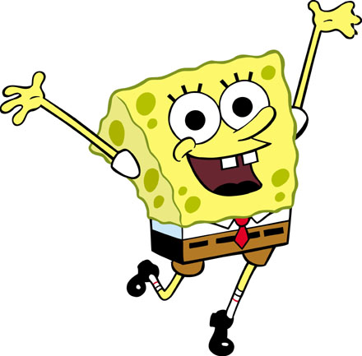
Student Sample Introduction
Spongebob Squarepants embodies the moral lessons that are crucial to a child's development. The show and its characters have a positive influence on today's youth; they encourage the values of hard work, amity, and determination.

Slide 5
Student Sample Introduction
Spongebob Squarepants promotes beneficial life lessons. His positive attitude and optimistic behavior encourages children's development.

Slide 6
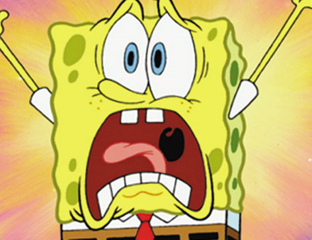
Student Sample Introduction
SpongeBob Squarepants promotes erratic and flawed behavior. Little white lies, wasting food, inappropriate movements, and being all around annoying is not “role-model” behavior for children.

Slide 7
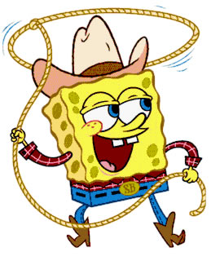
Student Sample Introduction
SpongeBob's endless positivity and work ethic could not provide children with a better show to watch. SpongeBob implants realistic means of achieving success into young viewer's minds.

Slide 8
Revised Student Introduction
SpongeBob instills realistic goals of achieving success into children's minds. The show exemplifies the importance of honesty and optimism in everyday life.

Slide 9
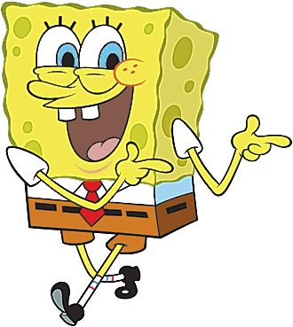
Student Sample Introduction
Spongebob Squarepants displays a positive attitude for children. It has been a beloved television show for years and reveals valuable messages for the viewing audience.

Slide 10
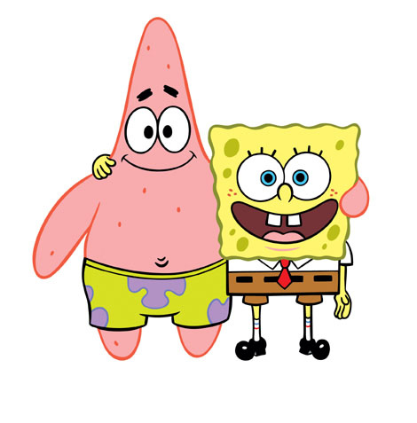
Student Sample Introduction
Spongebob Squarepants encourages sporadic behavior in young children. The erratic scene changes and buffoonery impair a child's attention span and ability to focus.

Slide 11
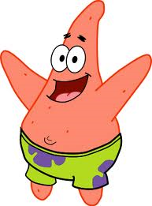
Revised Student Sample Introduction
Spongebob Squarepants encourages erratic behavior in young children. The spasmodic scene changes and buffoonery impair a child's attention span and ability to focus.

Slide 12
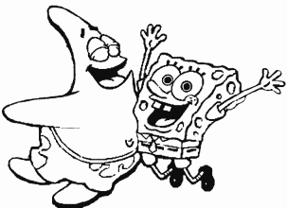
1st Premise Bank Argue … No Summary
* Spongebob can negatively affect behaviors in children without supervised attention.
* The show effectively promotes socially important behaviors like work ethic, sharing, and friendship.
* Spongebob is an age appropriate show for children ages 6 – 11.
* The bullying that occurs in Spongebob influences the morals of children.

Slide 13
1st Premise Bank
* The show displays what is wrong and what is right quite clearly.
* Positive goals from Spongebob build strong character.
* Spongebob’s work ethic and commitment to excellence are impeccable, and this passes on to our kids.

Slide 14
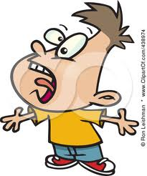
How To Synthesize
In each paragraph, you need to quote from at least 2 sources !!!

Slide 15
Student Sample Syllogism
Spongebob is an age appropriate show for children ages 6-11. Multiple tests have been done to try and prove that Spongebob is a morally wrong program. However, the tests have included children well under the targeted age group. Spongebob is initially intended for ages six to eleven; the only evident tests include children at the age of four. It is argued that the fast-paced television show “may disrupt the child ability to concentrate” (Lawson). But Lawson fails to tell the readers that the study is conducted with children two years younger than the suggested age. With a child of appropriate age, the brain is much more mature and can handle more fast-paced programs. A nine year-old can process the jumping around more productively than a four year old, based on the development of the brain. Within the fast-paced agenda of the little sponge, morals of a successful human being are illustrated to the appropriate viewers.

Slide 16
Syllogism Continued
If the child is under developed, the values may not be as visible, and the show may only be a large distraction. All television can become a distraction, however. Parents claim that television programs “have a negative effect on [their] childrens’ activity levels” (Wilkins). This has absolutely nothing to do with the show itself. Too much television will bring down a child’s activity, no matter the age or program. Spongebob is not a show that increases this harm. If a child is age appropriate and has a balanced amount of activity and television, there is no problem with viewing the show.

Slide 17
What the Syllogism Should Look Like
2nd Premise = Quote From At Least 2 Sources In the Paragraph
1st Premise = An Argument
Conclusion = Analysis of Your Quotes

Slide 18
Student Sample Syllogism
(1st Premise Must Argue)The show displays what is wrong and what is right quite clearly, making the show valuable for kids to watch. The article “Life Lessons Kids Can Learn From Watching SpongeBob SquarePants” states what good things can be learned from the show. It states that SpongeBob teaches that it’s right to “never give up, [that] friendships are important, and [to] work hard.” The episode Fools in April displays Squidward, SpongeBob’s neighbor, as incredibly heartless and mean, launching SpongeBob around the room in an April fool’s joke, and scolded verbally by disgusted customers. This clearly indicates that Squidward did something wrong. In the same episode, he later apologizes, making everything right. In the Episode Neptune’s Spatula, Mr. Krabs is seen betting on SpongeBob losing a contest, and after SpongeBob wins, he cries because he lost money.

Slide 19
Syllogism Continued
The significance of this is thatSpongeBob would be leaving forever, and Mr. Krabs is only worried about his money, rather than his own friend and fry cook. The multiple examples of displaying morals are not the only examples of good and bad deeds; there are more in the other episodes of SpongeBob Squarepants. The visual that Squidward and Mr. Krabs are portrayed as bad for doing unjust things elevates kids to do things opposite of what is shown: not hurting people and not being selfish. The morally correct traits stated in the article create good examples for children that will serve them in the future. The knowledge gained is valuable to the development of children, and helps better their daily lives.

Slide 20
Another Student Syllogism
1st Premise Must Argue a Point !!!
Embed Your Quotes !!!

Slide 21
The television series negatively influences the development in viewers. In “Fools April” Spongebob and Squidward incessantly prank each other, bordering on bullying. In one instance, Squidward even physically harms Spongebob until he cries. The young mind is highly influenced by things a child watches, and the children learn to act in the same ways as the characters. According to researchers “what they watch could be more damaging…” and television programs can negatively impact a child’s moral development. (Source five) Spongebob also is full of adult humor that is completely inappropriate for the 6-11 year old target demographic. The show’s take place in “Bikini Bottom”, where the main restaurant is called “The Krusty Krab”, the allusion to sexually transmitted diseases is uncalled for in a series that’s audience has yet to hit puberty. Spongebob has also been accused of “gay-promotion” and children might not develop relationships that are considered appropriate because they are confused, watching a show that shows same-sex friends acting as if they’re in a romantic relationship.

Slide 22
Another Student Syllogism
1st Premise Must Argue a Point !!!
Embed Your Quotes !!!

Slide 23
The character Spongebob emulates assiduous behavior that serves as a paragon for children. The hero’s industrious nature is constant, and is continuously rewarded in the show; hard work is shown as a requirement to make one’s life fulfilling, creating a goal for the viewers of Spongebob to strive for. In several episodes, viewers are reminded of Spongebob’s flawless record as “employee of the month”. His ongoing excellence on the job is distinguished as a positive attribute. As “Life Lessons Kids Can Learn From Watching Spongebob” describes, many managers watching the show with their kids would “wish they had just one Spongebob under their employment.” Not only this, but the protagonist demonstrates unbeatable enthusiasm for his job, despite the seemingly little importance of the fry cook position. Spongebob Squarepants is dedicated, a trait that is so vital to the society of modern U.S., primarily in the business world. The hero is shown in one episode making the patties with love and care, giving attention to each detail to reach perfection. He feels that “making the best Krabby Patty possible equates to a great work of Picasso.” The sponge is an excellent role model in that he teaches children the importance of striving for perfection when doing what you love. Spongebob highlights the benefits of productivity, and encourages kids to work hard, just like him.

