Slide 1
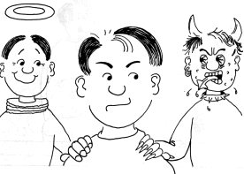
Moral Dilemma
Argumentative &
Persuasive Essay

Slide 2
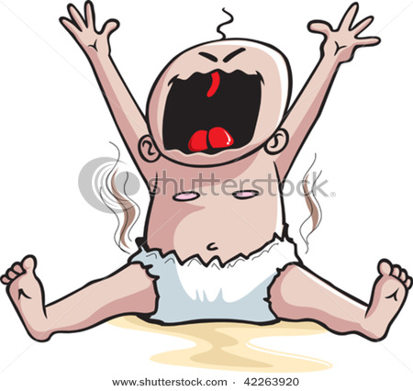
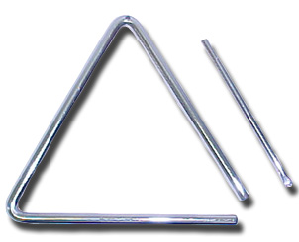
Writing the Thesis Statement
DECLARE YOUR THESIS

Slide 3
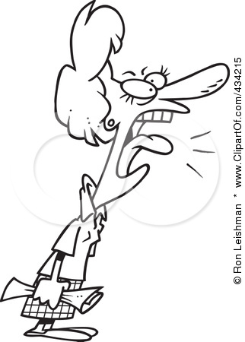
Student Sample Introduction
The sheriff’s department made the correct decision morally and circumstantially in order to protect the community. Animal cruelty and protection have always been a debatable and argumentative topic amongst advocates and organizations. Animals indeed should be treated with respect, however, when the welfare of the public is in question, action must be taken.
Blah … Blah … Blah
Declare Your Thesis!!

Slide 4
Student Sample Introduction
Penn State did the right thing in firing Joe Paterno. He failed in meeting his moral obligation not only as a coach, but as a human being. He knew that a young child was sexually molested by one of his colleagues and he didn’t do enough. The right thing to do in this instance was to notify the police, a decision that Paterno did not make.
Just come right out and state your position

Slide 5
Student Sample Introduction
The sheriff’s department did the only thing they could do in this situation – protect the community by eliminating a danger. While some of these animals are near extinction and very rare, they also pose an enormous threat to people when they are released from captivity. The decision was simple: put the community at risk or kill these animals? The best decision was clearly made.
Really guys, all you need to do is have a position and declare it

Slide 6
What Is Wrong With This Thesis?
Not too long ago Joe Paterno was fired as the head football coach at Penn State University. It was said that there was a sex scandal there and he did nothing about it. One of the assistant coaches was seen sexually molesting a young boy in the shower.

Slide 7
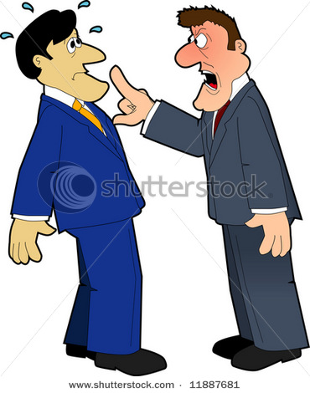
What Is Wrong With This Thesis?
In the month of October 2011, several exotic animals were killed when their owner committed suicide and released them. Members of the sheriff’s department shot at these animals. In the end, more than 20 animals were killed.
DON”T SUMMARIZE … DECLARE A POSITION!!

Slide 8
The Body Paragraphs: Go Syllogistically
1st Premise = An Argument … A Position … A Stance
2nd Premise = Textual Support (Quotes)
Conclusion = You Quoted … Now Analyze It!!

Slide 9
Sample Body Paragraph
The university had no other option but to fire Paterno. In moral terms, he “looked the other direction as Sandusky allegedly continued to molest young boys for seven more years.” There unquestionably was a chain of command that Paterno should have followed. He did the right thing in telling his superiors, but as the “most powerful and influential figure on the Penn State campus, he should have done more.” Paterno was aware of Sandusky’s conduct, yet he allowed it to continue by not involving the police. As for the 57% of people that don’t think Paterno should be fired, I disagree. He sat back and watched his “Success with Honor” become a “giant ‘L’ in the human being department.” Paterno’s lack of action was morally irresponsible and damning to several young boys. He is to blame; he is at fault.

Slide 10
The Body Paragraphs: Go Syllogistically
1st Premise = An Argument … A Position … A Stance
2nd Premise = Textual Support (Quotes)
Conclusion = You Quoted … Now Analyze It!!

Slide 11
Student Sample
Joe Paterno should not have been fired based on the allegations surrounding him & Penn State. Once he found out about the incident with Jerry Sandusky, “[he] then informed Curley of the incident.” Tim Curley – the athletic director – should have then informed the authorities. Paterno did what he should have done. Curley was charged with perjury and failure to report it to authorities and yet he wasn’t fired? Paterno did his job by telling the people above him about these allegations and he “got the boot.” I know that Curley resigned but did the school even offer Paterno a chance to resign? I’m guessing they didn’t because I feel Joe Paterno would have taken that option. Instead the school fired him over the phone. I feel like if you’re going to get rid of a man who has been there for nearly half a century ….

Slide 12
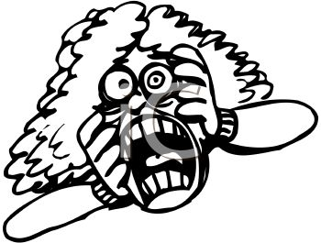
Come On You Knuckleheads
ARGUE!!!
DON’T SUMMARIZE!!!

Slide 13
DO THESE 1ST PREMISES ARGUE OR SUMMARIZE?
The sheriff’s department had no choice but to kill these animals.
After 46 years as their head coach, Penn State fired Paterno.
Paterno had a moral obligation to do more. He should have contacted the police.
In October, 48 exotic animals were released and then killed.

