Slide 1
Most interesting French- speaking people from history

Slide 2
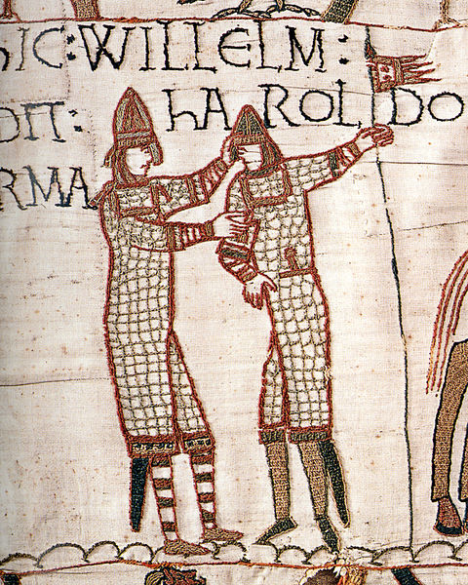
William the Conqueror Gauillaume le conquerant
William the Conqueror (1028-1087) lived in Normandy, in Northern France, though he was of Viking descent. In 1066, he invaded and occupied England, imposing French as the language of government in England. For decades, all English nobility were forced to become familiar with French, so many French words became a normal part of the English language. This is why learning more about French helps you learn to speak and read English better. Also, William the Conqueror enacted out the first census of England, called the Doomsday Book, which became a source of information for anyone interested in Medieval British history.
http://ed.ted.com/lessons/how-did-english-evolve-kate-gardoqui

Slide 3
Joan of Arc
Known in France as Jeanne D’Arc (lived about 1412-1431), as a teenage girl she joined the French army. As a woman, serving in a war was just not done, but Joan of Arc felt that God was calling her to serve the French nation. Joan’s enthusiasm and confidence inspired her fellow soldiers and she is credited with turning the tide of the Hundred Years war with Britain. The English were eventually defeated and left France. Joan, however, was burned at the stake for saying that she heard “voices” from heaven. Her story has inspired countless writers and filmmakers, and she was made a saint of the Catholic church in 1920.
http://www.youtube.com/watch?v=7jkh9J_b5HM&list=PL75140DF694F50778&index=1&feature=plpp_video

Slide 4
King Louis XIV
King Louis the 14th of France (1638- 1715) was also known as the Sun King. Under Louis XIV, France became the most powerful nation in the Western world. Louis XIV believed that a king’s power should be absolute, and ruled accordingly. But he also fostered French writers, artists and French culture in general. Louis was famous for his extravagant lifestyle, which both impressed rulers of other European nations and, eventually, caused great dissatisfaction among French people. But during his life, France was rich enough that most French people were proud of their king and his rule.
https://www.youtube.com/watch?v=ZxMdg2PSa84

Slide 5
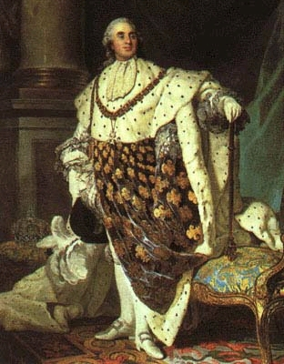
Louis the XVI and Marie Antoinette
King Louis the sixteenth (1754-93) was the great- great grandson of Louis XIV. His wife and queen Marie Antoinette (1755-93) came from Austria, but was taught French as a child so she could marry the French king. Historians don’t consider either ruler particularly bad (or good). At first, they did continue the tradition of Louis’s grandfather by living lavishly. Marie Antoinette became infamous for her expensive clothes and parties. When it became obvious that the French people…
http://www.youtube.com/watch?v=1WjsqVwWyrI&feature=BFa&list=PL75140DF694F50778

Slide 6
Louis the XVI and Marie Antoinette (cont)
…considered the royal family’s lifestyle unacceptable, they did try to cut back. But by 1789, the French people felt that someone must pay for their suffering and lack of food. The French wanted their nation to be a democratic republic, like the US, not a kingdom. In October, an angry mob surrounded the king and queen’s residence at Versailles and took the family to jail. Eventually, Louis XVI and Marie Antoinette were guillotined.
http://www.youtube.com/watch?v=dHHp6xqEc8c

Slide 7
Napoleon Bonaparte
Napoleon Bonaparte (1769- 1821) was born on the island of Corsica, and spoke mainly Italian, but because Corsica was part of France at the time, he considered himself French. Following the French Revolution, he seized control of France in 1799. He led the French army to create an empire which included much of Europe and Northern Africa as well. In 1812, his fortune turned and he was defeated at the battle of Waterloo. The most important legacy of Napoleon's dictatorship is the Napoleonic Code. These rules were of major influence to modern law.
https://www.youtube.com/watch?v=VEZqarUnVpo

Slide 8
Eugene Vidocq
In his early years, Eugene Vidocq (1775-1857) was a criminal who successfully escaped from jail several times. Around the year 1810, he turned his life around, using his knowledge of illegal activities to invent the science of criminology. He is now known as the father of modern forensics (criminal investigation). He was the first to make wax impressions of footprints at a crime scene and created the first private detective agency. He also helped form the police force of Paris. He became so well known in France that several authors of his day wrote novels about him.

Slide 9
Alexandre Dumas
The grandson of a French nobleman and a Haitian slave, Alexandre Dumas (1802-1870) had little education. But he was raised on the tales his mother told him of his late father’s adventures in the service of Napolean’s army. He would go on to write numerous adventure tales including The Three Musketeers and The Count of Monte Cristo.
http://www.youtube.com/watch?v=JG7FDivQLac&feature=BFa&list=PL75140DF694F50778

Slide 10
Louis Braille
Louis Braille (1809- 1852) was born with the ability to see but lost it when he was young. The son of a shoemaker, he played with a sharp shoemaking tool one day and accidently pierced his eye. The other eye became infected as well and soon he was blind. At the school for the blind in Paris, he was taught a system of writing using raised French lettering, but it was difficult to tell the letters apart by touch. With help from others, he pioneered a system of raised dots that was much easier to use. At first, the school Braille attended banned the use of his alphabet, but soon it became standard for all writing for the blind.
http://www.youtube.com/watch?v=OFyY7u95nxw&feature=relmfu

Slide 11
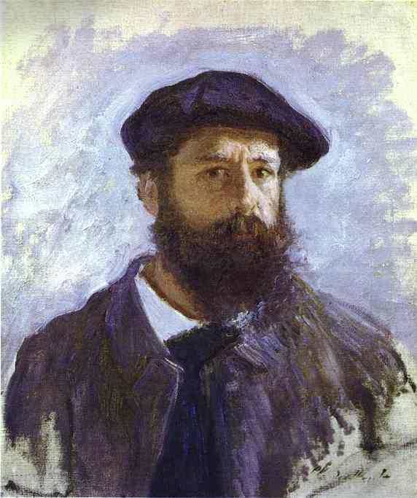
Claude Monet
Claude Monet (1840-1926) was one of the most famous French artists. Because his paintings were less realistic and more dreamlike, Monet’s work was initially very unpopular. He and the other “French Impressionists” had a hard time even giving away their paintings! But as tastes changed in the late 1800’s, people began to appreciate how he used his imagination in the way he painted everyday objects. By the early 1900’s people began paying millions of dollars for works by French Impressionists. Some of Monet’s most famous paintings were of the water lilies at his home in Northern France.
http://www.youtube.com/watch?v=fSXrTkpgE6o

Slide 12
Marie Curie
Marie Curie (1867- 1934) was born in Poland but moved to France while in college in order to get the best education then available. She and her French husband, Pierre, investigated radioactivity, as well as the elements called Polonium and Radium. She and her husband won a Nobel Prize for Physics in 1903 and (after his death) she was awarded a Nobel Prize for Chemistry in 1911. She was the first female head of the Physics Department at the Sorbonne University in Paris, which is like the Harvard of France.
https://www.youtube.com/watch?v=RLdiP8_8YIQ

Slide 13
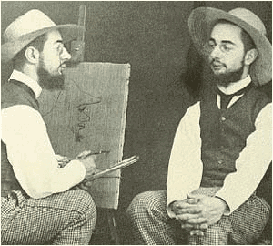
Henri de Toulouse- Lautrec
Henri de Toulouse-Lautrec (1864-1901) was the son of a noble family in the south of France. He was also an illustrator and painter who was shockingly modern for his time. His paintings show scenes in bars in Paris at night, particularly the Moulin Rouge dance house. He was a dwarf and an alcoholic, so he suffered from health problems. Because of this, he died relatively young.
http://www.youtube.com/watch?v=oxEdMhU-dIc&feature=fvwrel

Slide 14
Pierre de Coubertin
The Baron Pierre de Coubertin (1863-1937) was born into an aristocratic family. He was a scholar and writer who was a fan of sports, especially rugby. He also started a major scouting organization in France. De Coubertin used his influence and political skills to reestablish the modern Olympics in 1896. He created the International Olympic Committee and became its first president. The committee awards a Coubertin Award to athletes participating in each Olympics who exhibit exceptional sportsmanship.
http://www.youtube.com/watch?v=eR_JYPUKrnE&feature=BFa&list=PL75140DF694F50778

Slide 15
Coco Chanel
Gabrielle “Coco” Chanel was born poor in 1883. By the time she died in 1971, she and her company, Chanel, had become the most famous icons of international fashion. Chanel was so revolutionary mainly because her fashions were simple and elegant. Previous to 1900, women were used to their clothes being flouncy, uncomfortable and complicated. But modern life demanded that women be more active and soon women wanted the freedom of movement that had always been available from the styles of clothes that men wore. Coco Chanel was the first designer who supplied women with the clothes we now think of as modern.
http://www.youtube.com/watch?v=isEnyrd2Moc&feature=BFa&list=PL75140DF694F50778

Slide 16
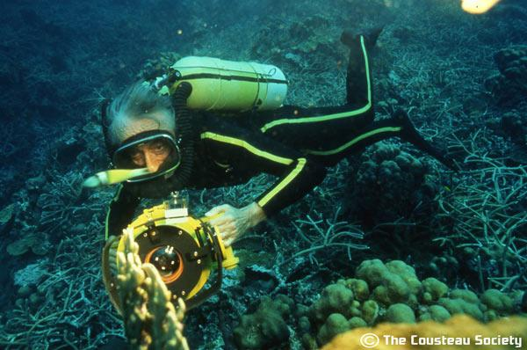
Jacques Cousteau
Jacques Cousteau (1910-97) was one of the most famous ocean scientists of all time. His first underwater experiments were done while he was in the French navy. But in order to do the research that he really wanted to do, he needed to improve the under water swimming technology of his time. He and a friend engineered the aqua lung (the precursor to scuba gear) so they could stay underwater longer and then tested their invention on themselves. Cousteau really became famous when he began making underwater nature documentaries. By the time of his death he filmed more 120 television documentaries, wrote 50 books and started an environmental organization that is still active today, known as the Cousteau Society in this country.
http://www.youtube.com/watch?v=BgvzrVD6xww&feature=BFa&list=PL75140DF694F50778

Slide 17
André “the Giant” Roussimoff
André Roussimoff was born in France to parents who were from Poland and Bulgaria. He suffered from acromegaly and by around age 14 could not fit on the school bus. He was driven to school by playwright Samuel Beckett, who was a friend of his father. At 18, he moved to Paris and became a professional wrestler. He sometimes wrestled under the name Monstre Tour Eiffel, and was supposed to be 7’ 4” and in excess of 400 pounds. Because of the physical condition that caused his extreme size, he became unwell and appeared in wrestling more infrequently by the mid 80’s. Instead he turned to acting, and is probably best known for his role as Fessik in the movie The Princess Bride.
http://www.youtube.com/watch?v=DP5-qJSzDUg&feature=BFa&list=PL75140DF694F50778

Slide 18
Kamini
Kamini Zantoko (born 1979) is the son of a doctor from the Congo. His father’s job brought his family to the rural French village of Marly-Gomont, where all the villagers were white. Part comedian and part rap musician, Kamini wrote and performed an original song on youtube, which became a phenomenon. In this song, entitled “Marly-Gomont,” he speaks of how it felt to grow up as the only Black family in this small French town. Since this occurred, Kamini has created more music for youtube and has been appearing on French television as well.
http://www.youtube.com/watch?v=nl-Db3_qsSM&feature=autoplay&list=PL75140DF694F50778&playnext=1

Slide 19
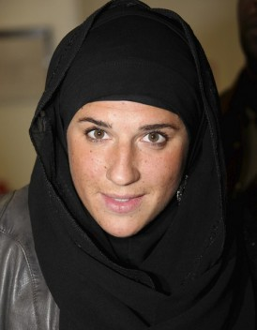
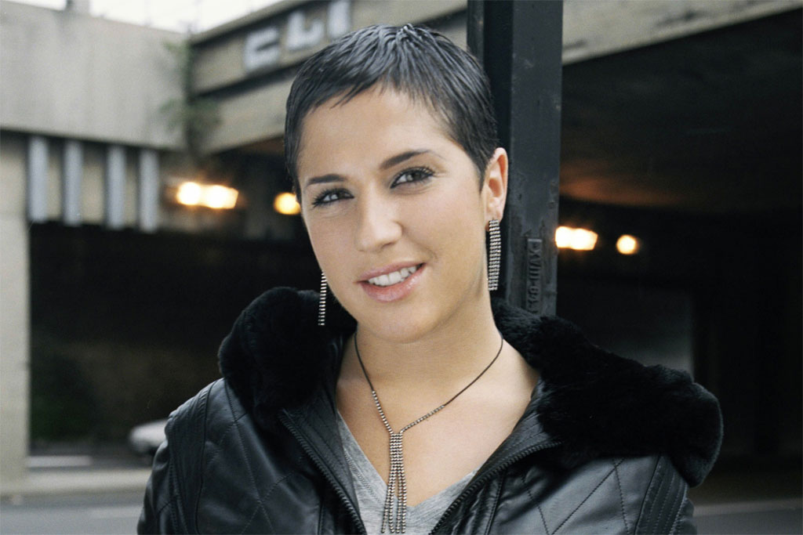
Diams
Mélanie Georgiades (born 1980) was born in Cyprus, identifies herself as Greek, but has lived in France most of her life. At age 18, she became famous as a rapper and hip-hop artist and was soon the most popular such artist in France. Some of her songs spoke out against French right-wing politicians like Nicolas Sarkozy and Jean-Marie Le Pen because these leaders felt that immigrants were making France a less powerful and more dangerous country. About four years ago, however, Diams converted to Islam and left the music business because she said that the industry made her unhappy. She is married now and shows no signs of returning to public life.
https://www.youtube.com/watch?v=3NM1VY4NugA
https://www.youtube.com/watch?v=iPPkRFMwZjA

