Slide 1
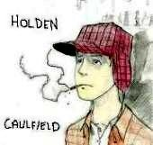
The Catcher in the Rye
Phony Crap
Board Game

Slide 2
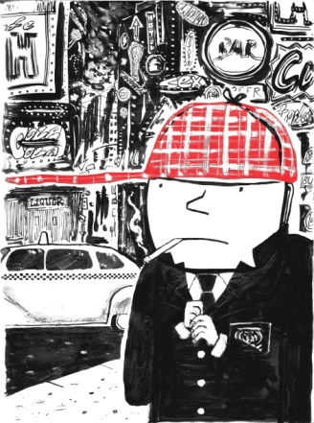
Directions:
The class will split up into three teams
When it is your team’s turn, you will spin the “phony spinner.” At this point in time, your team will be posed a question. If the question is answered correctly, your team will move your icon the amount of spaces indicated on the “phony spinner.”
Questions should be answered on a team basis. Please refer directly to the text.
During the discussion, all team members must follow along in the text and work on completing their Reader Response Journals.

Slide 3
1
2
8
3
7
4
6
5
SPIN

Slide 4
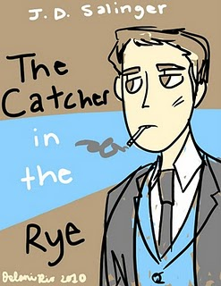
Chapter 13
Holden explains to us that he is still a virgin. What is his rationale for this? Use a quote to help support your answer.
Analyze and interpret: “The trouble is, I get to feeling sorry for them. I mean most girls are so dumb and all. After you neck them for a while, you can really watch them losing their brains. You take a girl when she really gets passionate, she just hasn’t any brains”(92).

Slide 5
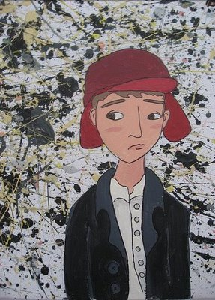
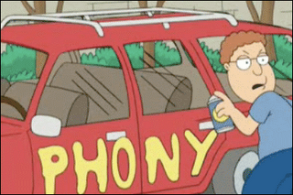
START
Go ahead 2 spaces
Miss one turn
Go back 2 spaces
Go back 2 spaces
Go ahead 2 spaces
Go ahead 2 spaces
END
Slide on Over
Go back 2 spaces
Slide on Over
Take an extra turn
Take an extra turn
Go ahead 2 spaces
Take an extra turn

Slide 6
1
2
8
3
7
4
6
5
SPIN

Slide 7
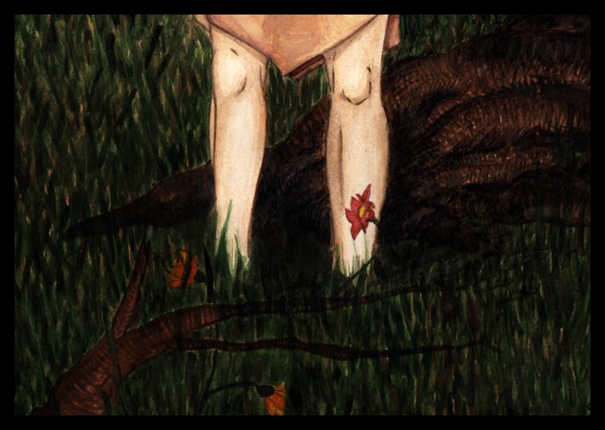
Chapter 13
Holden asks Sunny, “Don’t you feel like talking for a while?”(95). Why does Holden feel so much like talking in a time like this? Use textual references to help support your answer.
9. Holden tells us upon hanging Sunny’s dress, “The salesman probably just thought she was a regular girl when she bought it. It made me feel sad as hell – I don’t know why exactly”(96). Play Freud on Holden – Why does he feel this way?

Slide 8
START
Go ahead 2 spaces
Miss one turn
Go back 2 spaces
Go back 2 spaces
Go ahead 2 spaces
Go ahead 2 spaces
END
Slide on Over
Go back 2 spaces
Slide on Over
Take an Extra Turn
Take an extra turn
Go ahead 2 spaces
Take an extra turn

Slide 9
1
2
8
3
7
4
6
5
SPIN

Slide 10
Chapter 14
Explain Holden’s thought process in the following passage: “I felt so depressed, you can’t imagine. What I did, I started talking, sort of out loud, to Allie. I do that sometimes when I get very depressed and keep telling him to go home and get his bike and meet me in front of Bobby Fallen’s house”(98).
4. Holden tells us, “What I really felt like, though, was committing suicide. I felt like jumping out the window. I probably would’ve done it, too, if I’d been sure somebody’d cover me up as soon as I landed. I didn’t want a bunch of rubbernecks looking at me when I was all gory”(104).
Analyze and interpret Holden’s “rubberneck” sentiments
Would Holden actually commit suicide? Support your answer by using direct textual references.

Slide 11
START
Go ahead 2 spaces
Miss one turn
Go back 2 spaces
Go back 2 spaces
Go ahead 2 spaces
Go ahead 2 spaces
END
Slide on Over
Go back 2 spaces
Slide on Over
Take an Extra Turn
Take an extra turn
Go ahead 2 spaces
Take an extra turn

Slide 12
1
2
8
3
7
4
6
5
SPIN

Slide 13
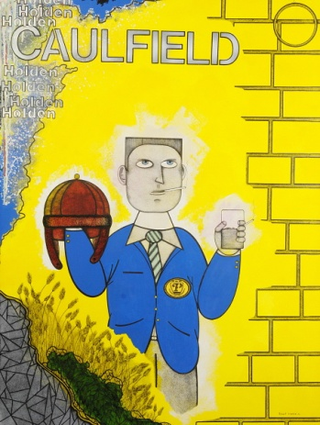
Chapter 15
Holden makes plans with Sally Hayes to see a matinee. He refers to her as a phony and a pain in the ass. Why, then, would he have any interest in spending time with her?
3. Holden has a strange impulse to give the two nuns in the diner $10-. Since we know he is low on money, what do you believe his motivations are in doing this?

Slide 14
START
Go ahead 2 spaces
Miss one turn
Go back 2 spaces
Go back 2 spaces
Go ahead 2 spaces
Go ahead 2 spaces
END
Slide on Over
Go back 2 spaces
Slide on Over
Take an Extra Turn
Take an extra turn
Go ahead 2 spaces
Take an extra turn

