Slide 1
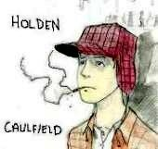
The Catcher in the Rye
Phony Crap
Board Game

Slide 2
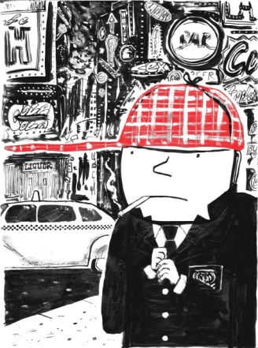
Directions:
The class will split up into three teams
When it is the team’s turn, they will spin the “phony spinner.” At this point in time, the team will be posed a question. If the question is answered correctly, the team will move their icon the amount of spaces indicated on the “phony spinner.”
Questions should be answered on a team basis
During the discussion, all team members must follow along in the text and work on completing their Reader Response Journals.

Slide 3
1
2
8
3
7
4
6
5
SPIN

Slide 4
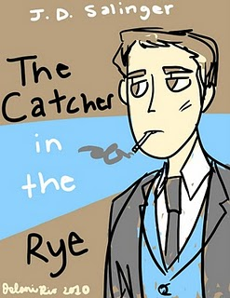
Chapter 16
2. . In this chapter we receive our first glimpse at the significance of the title of the novel. Holden sees a 6-year-old kid walking a straight line down a NYC street. Holden says of the scene, “The cars zoomed by, brakes screeched all over the place, his parents paid no attention to him, and he kept on walking next to the curb and singing, ‘If a body catch a body coming through the rye.’ It made me feel better. It made me feel not so depressed anymore”(115).
What is the significance of the song in relation to the book?
Why does this kid and his song make Holden feel better?

Slide 5
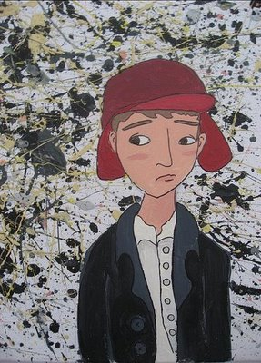
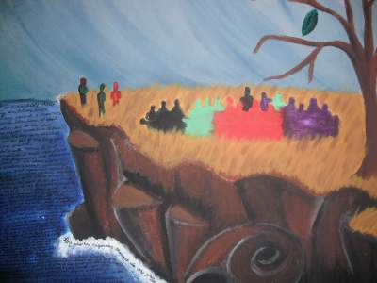
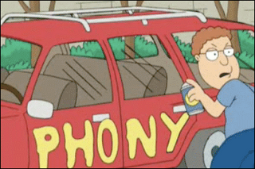
START
Go ahead 2 spaces
Miss one turn
Go back 2 spaces
Go back 2 spaces
Go ahead 2 spaces
Go ahead 2 spaces
END
Slide on Over
Go back 2 spaces
Slide on Over
Take an extra turn
Take an extra turn
Go ahead 2 spaces
Take an extra turn

Slide 6
1
2
8
3
7
4
6
5
SPIN

Slide 7
Chapter 16
3. Holden maintains a special fondness for childhood and his memories often elicit happiness. For example, Holden reflects: “We had this teacher, Miss Aigletinger, that took us there damn near every Saturday. Sometimes we looked at the animals and sometimes we looked at the stuff the Indians had made in ancient times. Pottery and straw baskets and all stuff like that. I get very happy when I think about it. Even now”(120). Why does Holden cherish these memories of childhood?

Slide 8
START
Go ahead 2 spaces
Miss one turn
Go back 2 spaces
Go back 2 spaces
Go ahead 2 spaces
Go ahead 2 spaces
END
Slide on Over
Go back 2 spaces
Slide on Over
Take an Extra Turn
Take an extra turn
Go ahead 2 spaces
Take an extra turn

Slide 9
1
2
8
3
7
4
6
5
SPIN

Slide 10
Chapter 16
4. Analyze and interpret Holden’s thought process and explain what he says he can’t explain: “Nobody’d be different. The only thing that would be different would be you. Not that you’d be so much older or anything. It wouldn’t be that, exactly. You’d just be different, that’s all. You’d have an overcoat on this time. Or the kid that was your partner in line the last time had got scarlet fever and you’d have a new partner. Or you’d have a substitute taking the class, instead of Miss Aigletinger. Or you’d heard your mother and father having a terrific fight in the bathroom. Or you’d just passed by one of those puddles in the street with gasoline rainbows in them. I mean you’d be different in some way – I can’t explain what I mean”(122)

Slide 11
START
Go ahead 2 spaces
Miss one turn
Go back 2 spaces
Go back 2 spaces
Go ahead 2 spaces
Go ahead 2 spaces
END
Slide on Over
Go back 2 spaces
Slide on Over
Take an Extra Turn
Take an extra turn
Go ahead 2 spaces
Take an extra turn

Slide 12
1
2
8
3
7
4
6
5
SPIN

Slide 13
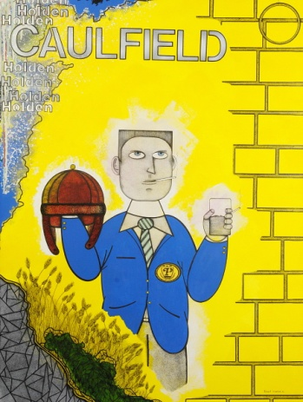
Chapter 19
3. Holden typically finds his acquaintances to be phony, pretentious, and shallow. According to Holden, these characteristics are not of his own. However, how might Carl Luce disagree with Holden? Use a quote to help support your answer.

Slide 14
START
Go ahead 2 spaces
Miss one turn
Go back 2 spaces
Go back 2 spaces
Go ahead 2 spaces
Go ahead 2 spaces
END
Slide on Over
Go back 2 spaces
Slide on Over
Take an Extra Turn
Take an extra turn
Go ahead 2 spaces
Take an extra turn

Slide 15
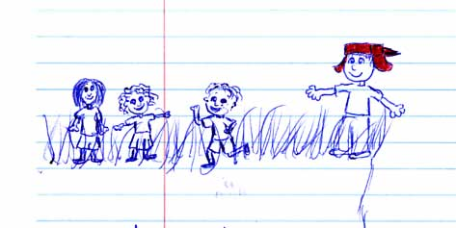
Chapter 20
Let’s explore every question in Chapter 20

