Slide 1
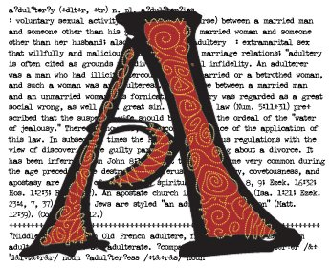
The Scarlet Letter
Overview & Introduction

Slide 2
Overview
Click Here

Slide 3
Introduction
Click Here

Slide 4
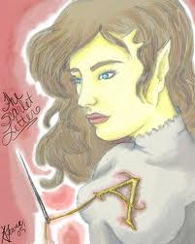
The Characters
Click Here

Slide 5
The Plot
Click Here

Slide 6
Themes
Click Here

Slide 7
Motifs
Click Here

Slide 8
Symbols
Click Here

Slide 9
Understanding
Click Here

Slide 10
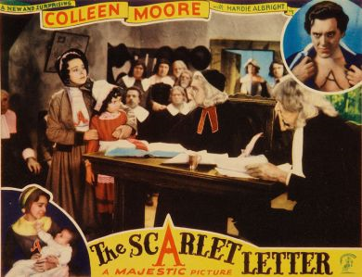
Letter Analysis
Click Here

Slide 11
Conclusion
Click Here

