Slide 1
Blockbusters!!!
Writing Equations

Slide 2
Rules of the Game
Two teams play against each other to make it across the board before the other team.
Team 1 asks for a letter. The teacher will click on that letter. Team 1 answers the question. If they are right, that block belongs to Team 1 and is colored in with Team 1’s color. If they are wrong, they do not get the block and it is now Team 2’s turn
Each team is trying to get across the board while also blocking the other team’s progress. The first team to make it to the other side wins.

Slide 3
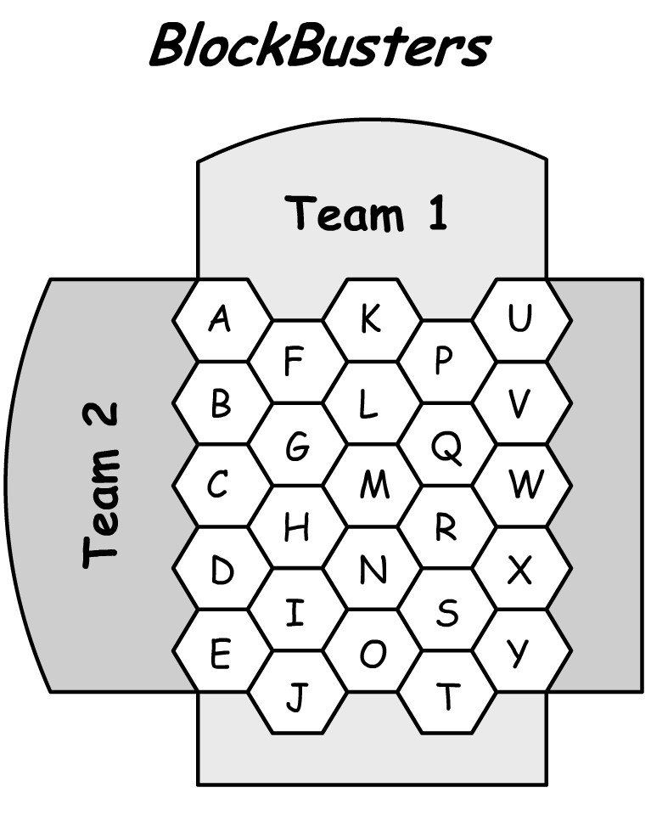
Choose a Question
A B C D E
F G H I J
K L M N O
P Q R S T
U V W X Y

Slide 4
A
Find the slope and y-intercept for the equation:
4x – 8y = 10

Slide 5
B
Find the coordinates of the x and y intercepts for the equation
5x + y = 5

Slide 6
C
Find the slope of the line between the two points
(5, -10) and (12, -7)

Slide 7
D
Is the point ( -8, -7 ) on the line whose equation has the following slope and y-intercept?
m = ½ ; b = -3

Slide 8
E
Find the slope and y-intercept for the equation:
6x – 7y = 28

Slide 9
F
Write the equation in slope-intercept form for the given point and slope
(-3, 4) with m = -2

Slide 10
G
Find the slope and y-intercept for the equation:
3x + 2y = 10

Slide 11
H
Is the point (4, 9 ) on the line whose equation has the following slope and y-intercept?
m = ; b =

Slide 12
I
Write the equation in point-slope form for the given point and slope
(3, -1) with m= -4

Slide 13
J
Find the slope of the line parallel to:
6x + 16y = 8

Slide 14
K
Write the equation of the line in slope-intercept form for the given point and slope
(8, 3) with m = ½

Slide 15
L
Find the slope of the line perpendicular to:
5x – 4y = -1

Slide 16
M
Find the slope of the line between the two points
(6, -7) and (2, -7)

Slide 17
N
Find the slope of the line perpendicular to:
4x – 3y = 7

Slide 18
O
Find the slope of the line between the two points
(-8, -5) and (-8, 5)

Slide 19
P
Find the slope of the line between the two points
(1, -2) and (2, 5)

Slide 20
Q
Write the equation of the line between the two points in point-slope form:
(-3, -2) and (4, 5)

Slide 21
R
Is the point ( 12, -2 ) on the line whose equation has the following slope and y-intercept?
m = ¼ ; b = -5

Slide 22
S
Write the equation of the line between the two points in slope-intercept form:
(6, 4) and (-8, 5)

Slide 23
T
Find the slope and y-intercept for the following equation:
4x + 7y = 14

Slide 24
U
Is the point ( -8, 10 ) on the line whose equation has the following slope and y-intercept?
m = ; b = 2

Slide 25
V
Write the equation of the line in point-slope form for the given point and slope.
(4, 9) with m =

Slide 26
W
Find the slope of the line parallel to the following line:
7x + 2y = 3

Slide 27
X
Find the coordinates of the x and y intercepts for the following line:
5x + 2y = 10

Slide 28
Y
Write the equation in slope-intercept form for the line containing the given point and given slope.
(-7, 2) and m=3

Slide 29
Z
Find the slope of the line between the two points
(-5, 0) and (-3, -8)

