Slide 1
WHAP Review #1
Foundations Period: 10,000 BCE- 600 CE
Mike Burns
whap4fun@gmail.com
American School of Doha
Doha, Qatar
April 2005

Slide 3
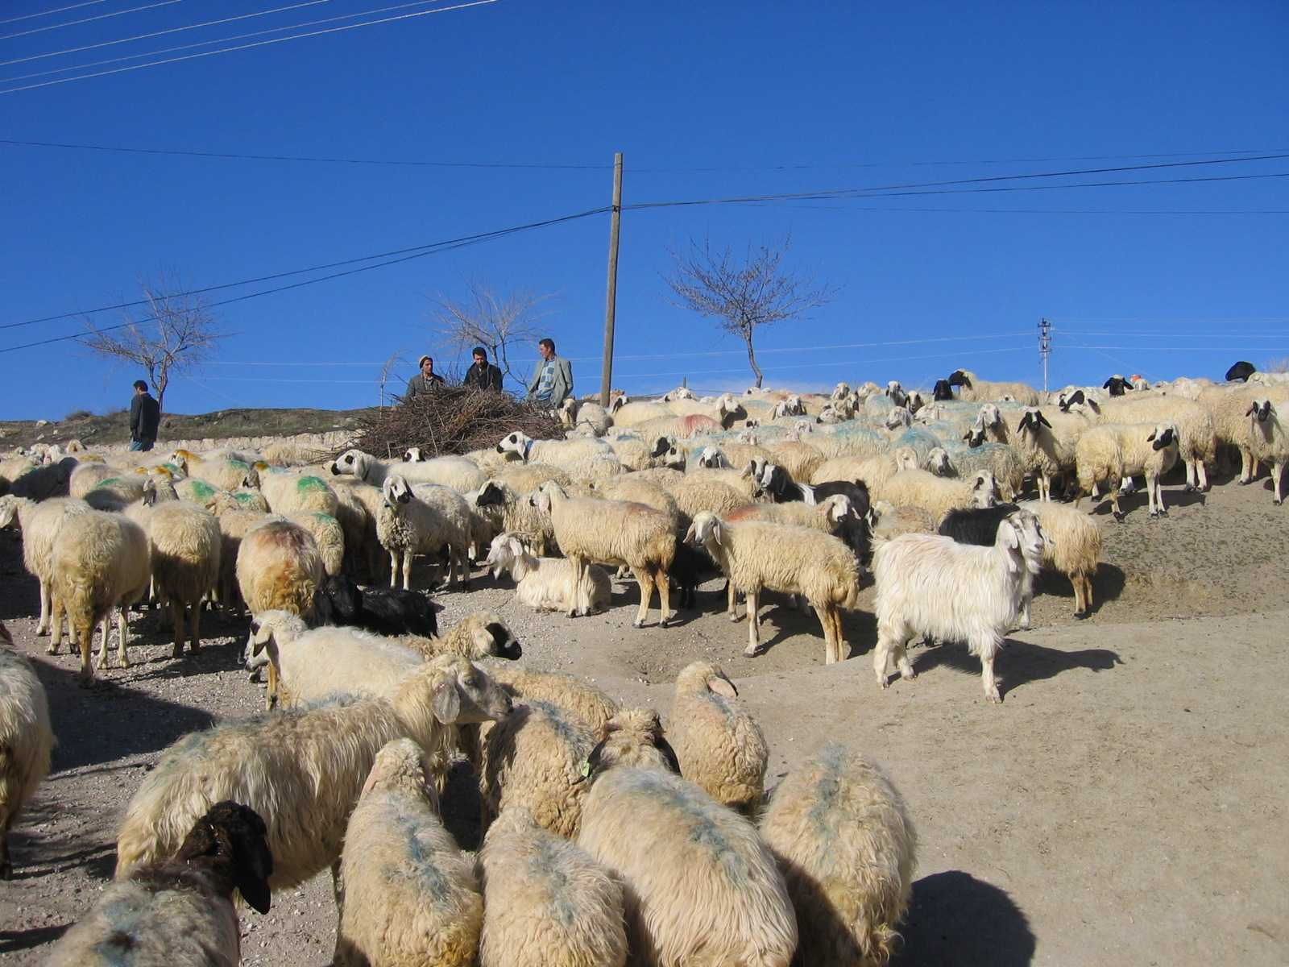
Nomads: Follow the Food
Foragers: Hunt & Gather
Tied to nature
Few possessions
Egalitarian nature
Pastoralists: Domestication of Animals
Mtns./low rainfall areas
Male-dominated
Stratified as size of herds grew
Leads to…

Slide 4
The Neolithic Revolution: 8000-3000 BCE
Agriculturalists: Plant Domestication
Community Development
Permanent settlements
Idea of land ownership: World View Shift
Sustained culture
Sense of identity

Slide 5
Consequences of a Food Surplus
Specialization of labor
Improved technology: metal working, irrigation
Stratification of society
Possessions
Armies
Religion
Writing
Government
Population density increases
Voila…Civilization

Slide 6
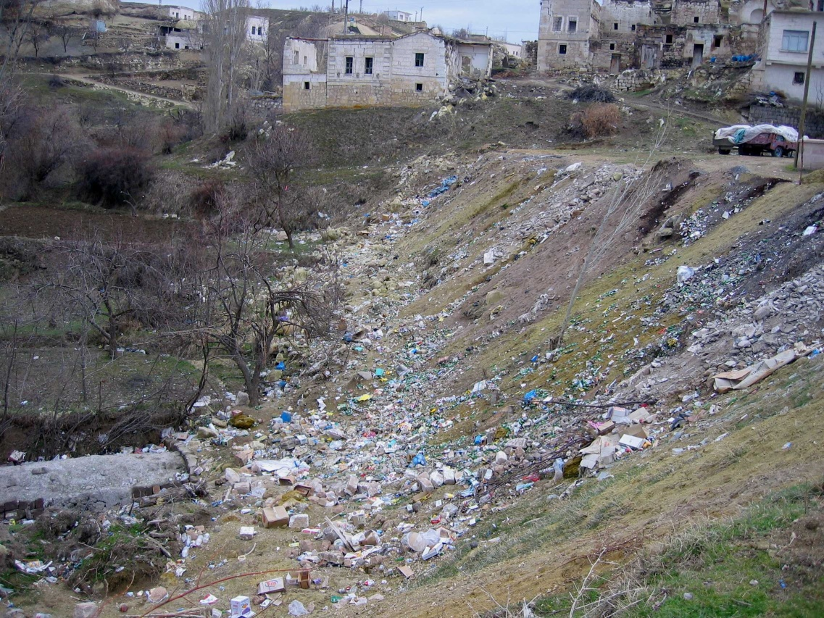
Environmental Impact
Use of water resources
Clearing of land
Use of building materials
Roads
Use of fuel materials
Animals, disease
Mining

Slide 7
River Valley Civs
Mesopotamia
Tigris, Euphrates = Fertile Crescent
Sumer, Babylon, Persia
Unpredictable flooding

Slide 8
Sumer: The first
Successful agriculture, river management
Writing, cuneiforms
Use of wheel
12 month calendar, base 60, geometry
Polytheistic
Ziggurats
Ur, Erech, Kish 3000 BCE
Overthrown by Akkadians 1700 BCE

Slide 9
Sumer to Babylon to Nineveh to Babylon
Overthrew Akkadians 1700 BCE
Hammurabi, Code of Law
Fell to Kassites, then Hittites 1500 BCE
Hittites-iron, then fell to
Assyrians-organized, cruel, Nineveh, exiles, cultural diffusion
Conquered by Medes, Chaldeans, rebuilt Babylon

Slide 10
Persian Immersion

Slide 11
By 500 BCE Nile to Turkey/Greece to Afghanistan
Great Royal Road, 1600 miles
Transportation, Communication
Multi-cultural Empire, Tolerance
Smaller Civs co-existed
Lydians-coined money
Phoenicians-22-letter alphabet, naval power
Hebrews-Judaism, monotheism

Slide 12
Walk Like an Egyptian
Rich soil, gentle flooding
3 Kingdoms
water management, pyramids, astronomy, hieroglyphs, calendar, gold, spices
Polytheistic
Women rulers, buy, sell property, inherit, will property, dissolve marriages, still subservient to men
Hierarchy: pharaoh, priest, nobles, merchants, artisans, peasants, slaves
Conquered by (1100 BCE) Assyrians, Persians, Greeks, Romans, Islam, Ottomans, Euros

Slide 13
Indus Valley

Slide 14
Indus Valley: 2500-1500 BCE
Outside contact more limited
Kyber Pass connection to outside
Harrappa, Mohenjo-Daro 100,000+ each
Master-planned, water system, strong central gov’t, polytheistic, written language
Pottery, cotton, cloth
Cities abandoned, reason unknown
Aryans arrive 1500 BCE

Slide 15
Aryans
From Caucasus Mtns. Black/Caspian Sea
Nomads who settled
Vedas, Upanashads basis for Hinduism
Caste system
warriors, priests, peasants
later re-ordered: Brahmins (priests), warriors, landowners-merchants, peasants, untouchables (out castes)

Slide 16
China: Shang on the Hwang

Slide 17
Shang: 1600-1100 BCE
Stable agri-surplus, trade-centered
N. China, walled cities, strong army, chariots
“The Middle Kingdom” World View
Trade with Mesopotamia
Bronze, pottery, silk, decimal system, calendar
Patriarchal, ancestors as advocates w/the gods

Slide 18
It’s Zhou Time
Replaced Shang around 1100 BCE
Ruled 900 years, kept customs, traditions
Mandate of Heaven
Feudal system, nobles gained, bureaucracies, war amongst feudal kingdoms, collapse 256 BCE

Slide 19
Exceptions to the Rule
Olmecs (Mexico), Chavin (Andes) developed similarly to others: urban, polytheistic, irrigation, writing, calendar, monumental building
The point: Similar pattern of development in different part of earth, no contact
The difference: Not River Valley Civs. No major river to use as transportation or generator of agri-production

Slide 20
The Classics: India-China
4 key empires 300 BCE-500 CE
India
Maurya
Gupta
China
Q’in
Han

Slide 21
Mauryan Empire 321-180 BCE

Slide 22
Mauryan Empire
Founded by Chandragupta Maurya
Unified smaller Aryan kingdoms
Greatest extent under Ashoka
Big time traders: silk, cotton, elephants (much more) to the west
Strong military, Ashoka converts to Buddhism: non-violence, moderation
Rock & Pillar edicts, Buddhism spread

Slide 23
Gupta Dynasty 320-467 CE

Slide 24
Rise of Gupta
Ashoka dies 232 BCE, Mauryan’s rapidly decline; econ problems, attacks from NE
375-415 CE, revival under Chandra Gupta
Smaller, more decentralized: Golden Age, peace, Arts & Sciences; pi, zero, 0-9, skilled iron workers
Hinduism resurgent
Women lost rights; own property, study religion, child marriages common
(6-7 years-old)
Collapsed 550 CE (White Huns)

Slide 25
Q’in Empire

Slide 26
Q’in Ups in China 221-209 BCE
Same same: strong agri-econ, strong army, iron, expansion…only lasted 10 years. Significance?
GREAT WALL…so what?
Strong centralized, brutal gov’t
Qin Shihuangdi emperor
Unified kingdom, standardized weights, measures, laws, written lang., zero dissent policy, patriarchal society
Legalism
Peasant rebellion brings down 209 BCE

Slide 27
A big hand for the Han!

Slide 28
Han Dynasty 200 BCE-200 CE
Resisted the Huns
Expanded into Central Asia
Silk Road to the Mediterranean
Buddhism spread, culture spread
Civil Service system, bureaucracies, resulting in stable gov’t.
paper money, sundials, calendars, metallurgy

Slide 29
Classical Civs in the Med

Slide 30
Greece and Rome: Roots of Western Civilization
Simply: they put it all together
Representative gov’t
Art
Architecture
Literature
Science
Philosophy

Slide 31
It’s Greek to me!
Impact of geography
Trade, not agri.
Est. colonies, strong military
Communications
Transportation
Governance

Slide 32
The Polis
City-states
Common identity, culture in each
Athens
Political, commercial, cultural center
Sparta
Agricultural, militaristic, equality w/o individuality

Slide 33
Hierarchy
Citizens-adult males, business-commerce
Free people w/ no political rights
Non-citizens (included slaves 1/3 of the Athenian pop!)
All citizens expected to participate in public life
Monarchy to aristocracy to democracy
Solon/Draco: aristocrats who worked to ensure fair, =, open participation

Slide 34
Religion
Polytheistic
Had human failings: got drunk, cheated on spouses, jealous, angry, took sides, etc.
Greek mythology remains a large part of Western heritage and language

Slide 35
War with Persia
Persia invades Greece twice. Despite great odds, Greece survives. Key battles: Marathon 490 BCE (land), Salamis 480 BCE (sea)
Greece controls Aegean
Period of peace and prosperity

Slide 36
Golden Age of Pericles
Athenian culture excels
Democracy for all adult males (citizens)
Delian League-city-state alliance
Socrates, Plato, Aristotle
Truth through rational thought and observation
Math, Science, Architecture, Literature

Slide 37
Super-power, super mistake
Athens dominated the Delian League
Peloponnesian War with Sparta (431 BCE)
Weakened, Macedonian conquest
Philip encouraged Greek culture
Followed by son, Alexander, unified Greece, invaded Persia

Slide 38
Alexander the Great?

Slide 39
Live fast, die young…
Alexander conquered Persia
Pushed to Egypt
Stopped at India
Empire divided into three:
Antigonid (Greece/Macedonia)
Ptolemaic (Egypt),
Seleucid (Bactria/Anatolia)

Slide 40
Hellenistic Era
Greek Culture and ideas flourished and spread
Alexandria (Egypt) became wealthy, center for learning
After death (323 BCE), empire crumbled
Macedonian focus on the east and Egypt left the door open for…

Slide 41
The Romans: 509 BCE-476 CE

Slide 42
Rome
Good Geographic position
Protected by mtns in north
Peninsula
Cross-roads in the Mediterranean
Polytheistic, borrowed many Greek gods, mythology still evident in West

Slide 43
Social-Political Structure
Patricians
Senate, Assembly
Plebians
Assembly
Consuls
Representative (as opposed to Direct in Greece)
12 Tables (innocent until proven guilty)
Patriarchal/Paterfamilias
Women influential in family, own property, still considered inferior
Slaves (up to 1/3) city better than country

Slide 44
Military Domination
All Directions, all the time
Punic Wars 264-146 BCE
Gained control of W. Med
Defeated Macedonians
Gaul
Spain
Road net, navy, aqueducts
Cultural diffusion

Slide 45
Republic, no-Imperialism, yes
Increased slavery, displaced plebians, inflation= social unrest
Senate weakened, Triumvirate, Caesar, Pompey, Crassus, Civil War
Caesar assassinated 44 BCE
2nd Triumvirate, civil war
Imperial Rome
Pax Romana

Slide 46
Pax Romana

Slide 47
Peace and Prosperity
Rome, capital of western world
Military expansion
Rule of law, common coinage. Civil service, secure travel for merchants
200 years of stability
Uniform laws, but traditional cultures in territories survived ie Egyptians, Hebrews
Growth of arts and sciences

Slide 48
A New Religion
Christianity competes with paganism
Christians persecuted
Conversion of Constantine ended persecution 312 CE
Edict of Milan-Christianity official religion of Rome

Slide 49
COMPARE
Golden Ages of Rome, Greece, Gupta, Others
Expansion of Territory, flourishing of art and science
Wealth flows in due to military expansion, confidence

Slide 50
“What goes up…”
Empires fall
Late Classical Period 200-600 CE
Steppe People on the move, dominoes fall
Han, Gupta, Roman Empires fall

Slide 51
Collapse of the Han
Wang Mang 9-23 CE, “Socialist Emperor”
Economic
Military drained budget
Confiscate land, raise taxes
Actions discouraged manufacture and trade

Slide 52
Collapse of the Han
Social
Rising tensions between rich and poor
Poorly conceived land reform program
Famine
Revolt, murder of Wang Mang
Han Dynasty briefly restored, full recovery impossible, collapse in 220 CE
400 years of regional kingdoms

Slide 53
Collapse of the Gupta
Huns 24/7
Gupta able to hold off for a while, at great cost
Hun kingdoms emerged in western & northern India
Culture survived, Hinduism, caste system, Gupta Empire did not

Slide 54
“Western Rome, you are the weakest link, good-bye”
284 CE, Diocletian splits W-E Empire

Slide 55
Why?
Attempt to re-gain control of
Military under imperial control
Co-emperors
Economy
Gov’t budget
Price caps to control inflation
Strengthen currency

Slide 56
Collapse
No singular reason
Rome sacked 410 CE, 476 CE
Internal decay
Weak or bad leaders
Expense of empire
Epidemics
External pressures
Huns, Visigoths
Sheer size

Slide 57
CONTRAST: Fall of Han, Gupta, Rome
Two major causes threaten all empires
Internal: economic depression, natural catastrophes, social unrest
External: Invading Armies
Internal: Han
External: Gupta
Combo Meal: Rome

Slide 58
Cultural Diffusion via the Silk Road

Slide 59
Ideas, Culture, Invention
Trade routes brought various peoples in contact
Pastoralists provided protection, services, supplies
Disease and armies also traveled the routes, plague, small pox, Mongols
Religion-Buddhism to China, SE Asia
Christianity through Med, Europe, Britain
Peoples: Anglo-Saxons to Britain, Huns to India, Germanic Tribes to Italy

Slide 60
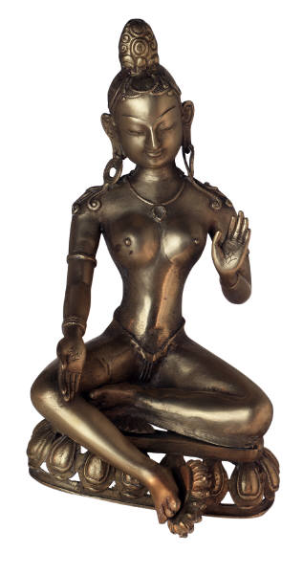
Religion: to 600 CE

Slide 61
Belief Systems through 600 CE
Polytheism
Confucianism
Daoism
Legalism
Hinduism
Buddhism
Judaism
Christianity

Slide 62
Commonalities
Schisms-Divisions resulting in subgroups, sects
Consider social, political, cultural, military impacts as well as theological and philosophical
Where did it start? Where did he spread? How?

Slide 63
Polytheism
Majority of ancient civs
Through 600 CE all Med and Mesop Civs were poly. Exceptions were Hebrews and Christians
In the East, all were poly; Aryans, Hindus, traditional Chinese, Daoists, some Buddhists, Americas, Africa

Slide 64
The Deity Details
Multiple gods, may be good or bad
Deities impact daily life
Human attributes (Grk-Rom)
Egypt: Benevolent and kind
Sumer, Aztec: Feared, to be appeased

Slide 65
The Big Deal?
major impact on civ development
Art & architecture
Ritual based
Rise of priestly class
Rigid social structures
Gods for culture as whole, city-state as well: rise and fall seen as battle of gods as well as city-states

Slide 66
Confucianism
Specifically Chinese (Kong Fu Tse) 400 BCE onward
Political-social philosophy, not religion
Moral, ethical, also practical
How to restore political-social order?
5 key relationships: political, parental, spousal, sibling, friends

Slide 67
Confucianism
Right relationships = right society
Put aside personal ambition for good of state
Ren-humanity, benevolence, kindness
Li-propriety, courtesy, respect, deference
Xiao-filial piety, family obligation, extended
Lead by good example
Women, 2nd status, honored by kids

Slide 68
The Big Deal?
As a ethical, social, political belief system it was compatible with other religions, could practice Buddhism and Confucianism simultaneously
Flexible
Embraced by leaders as well, ordered society, tight families
Exclusively Chinese, only in context of Chinese culture

Slide 69
Daoism-Taoism
China 500 BCE onward
“The Way” (of nature/cosmos)
Lao-tzu, philosopher
Eternal principles, passive, yielding
Like water, yet strong, shaping
Opening of a pot, nothing, yet not a pot without it
Wu wei- non-doing, harmony with nature

Slide 70
The Big Deal?
Self-sufficient communities
Counter to Confucian activism
Emphasis on harmony w/ nature leads gains: astronomy, botany, chemistry
Co-existed w/Confucianism, Buddhism, Legalism
Added to complexity of Chinese culture

Slide 71
Contrast: Confucianism-Daoism
Shared belief in spirits of the dead
Confucianism
creating orderly society
active relationships, active gov’t
To guide relationships
Daoism
harmony with nature, internal peace
Simple, passive life
Little gov’t interference
To guide individual in meditation

Slide 72
Legalsim
The Q’in Dynasty
Peace & order through centralized, tightly controlled state
Mistrust of human nature; reliance on tough laws
Focus on things the practical and sustainers of society
2 most worthy jobs: farmer, soldier

Slide 73
The Big Deal?
Accomplished swift reunification of China
Completion of projects like the Great Wall
Caused widespread resentment among common people, led to wider acceptance of Confucianism-Daoism

Slide 74
Contrast: Confucianism-Legalism
Social belief systems, not religions
Intended to create orderly society
Confucianism-fundamental goodness
responsibilities
Legalism-fundamental evil
punishments

Slide 75
Hinduism
Aryans, and empires of Indian subcontinent
Brahma-supreme force
Gods are manifestations of Brahma
Vishnu-preserver
Shiva-destroyer
Reincarnation
Dharma: rules and obligations
Karma: fate based on how dharma was met
Moshka: highest state of being, release of soul

Slide 76
The Big Deal?
Religion as well as social system
Caste system, accept lot in life, next one will be better (if dharma met)
Close relationship w/Indian culture, caste system have limited its spread
Treatment of animals
Hinduism spawns Buddhism

Slide 77
Buddhism
India, China, SE Asia
Hindu prince, Siddartha Gautama
Nepal 563-483 BCE
Search for meaning of human suffering
Buddha = enlightened one
No supreme being

Slide 78
Buddhism: 4 Noble Truths
Four noble truths
All Life is suffering
Suffering caused by desire
One can be freed of desire
Freed by following Eightfold path

Slide 79
Buddhism: Eightfold Path
Eightfold Path
Right views
Right aspirations
Right speech
Right conduct
Right livelihood
Right endeavor
Right mindfulness
Right meditation
Following the path
Leads to nirvana
State of perfect peace & harmony
May take several lifetimes
2 forms
Theraveda: meditation, harmony, Buddha not a god (Lesser Vehicle)
Mahayana: more complex, greater ritual, reliance on priests. Buddha a diety, bodhisattvas, nirvana “helpers”

Slide 80
The Big Deal?
Did not recognize castes
Appealed to lower classes (duh!)
Not attached to social structure, spread rapidly to other cultures
Ashoka adopted, thrived
Eventually reabsorbed into Hinduism
Thrived in China, Japan, SE Asia
Force of cultural diffusion via trade, missionaries

Slide 81
Judaism
The Hebrews
Chosen by God, special status
Personal relationship with God
Afterlife, tradition, doctrines, philosophy, personal salvation
To honor, serve God, promote prophets, maintain cultural identity
A religion & culture
The First Monotheistic Belief System:
Christianity
Islam

Slide 82
Compare: Confucianism, Hinduism, Judaism
Seem very different
Confucianism, not a religion
Hinduism, polytheistic
Judaism, monotheistic
All tied to the culture where the came from, not evangelical, converting others

Slide 83
Christianity
Splinter group of Jews, quickly spread throughout Roman Empire
Jesus, son of God, Messiah of Jewish prophecy
Devotion to God, love of fellow man
Jesus sent to redeem man from sin
Salvation by faith in divinity, death, and resurrection of Jesus.
Crucified by Jewish leaders and Roman gov’t 30 CE

Slide 84
The Big Deal
Emphasis on compassion, grace through faith, salvation, eternal life after death appealed to lower classes, women
By 300 CE, most influential in Med. Region
Spread north and west throughout Europe
Combo of religion & empire = huge impact on political, social development of Europe

Slide 85
Foundations: 3 Themes
Civilizations
Patterns, developments
Rise-fall of empires: why? consequences?
Sources of Change
Trade
Conquest
Invention, innovation, adaptation; iron, wheel
Man vs. Nature
Interaction? Role of geography? Attempts to measure/control?
Change from survival (physical needs) to internal peace (spiritual needs)

