Slide 1
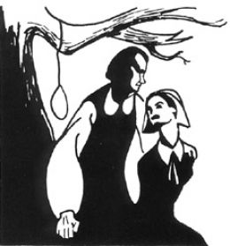
The Crucible
Text Overview
Click Here

Slide 2
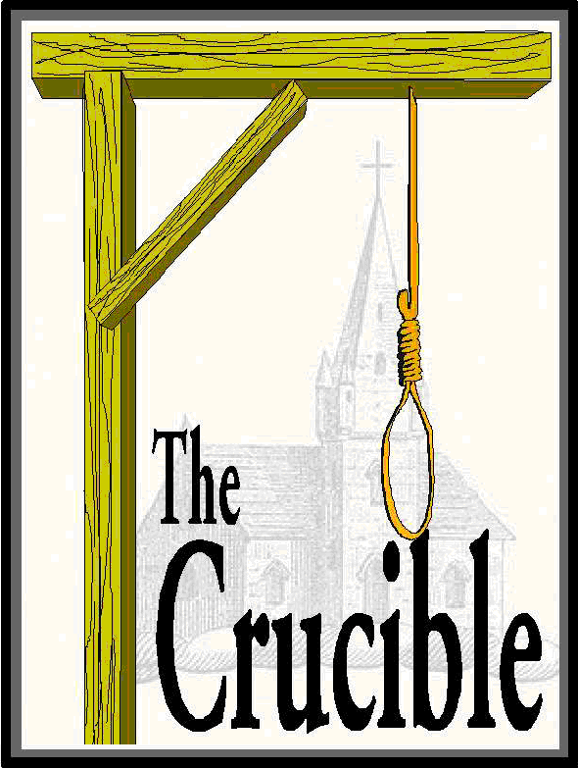
Historical Context
Click Here

Slide 3
Click Here
Plot Overview

Slide 4
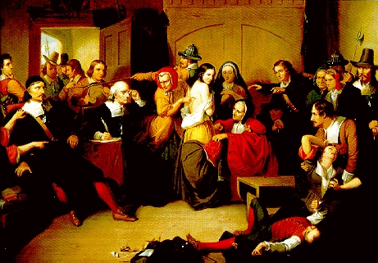
The Characters
Click Here

Slide 5
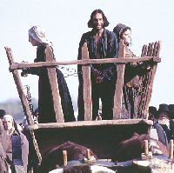
John Proctor
Click Here

Slide 6
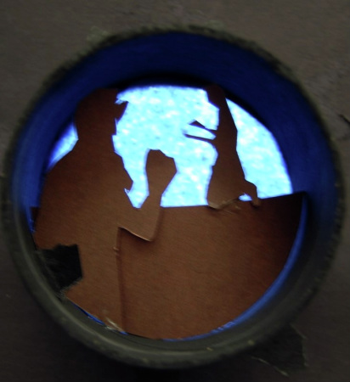
Themes
Click Here
And Here

Slide 7
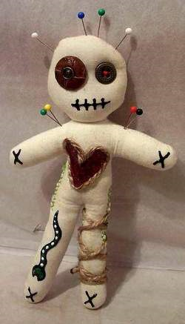
Symbols
Click Here

