Slide 1
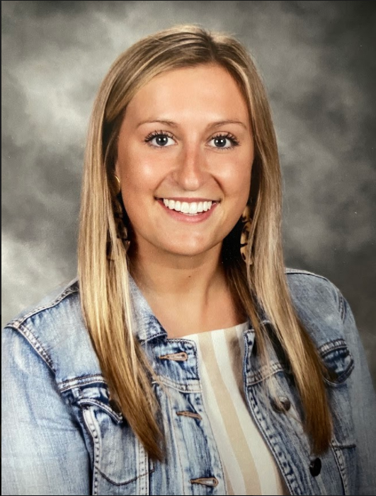
About Miss Cady
Welcome to 6th grade! I am so excited to be your teacher and I think this is going to be the best year ever. Before I meet you, I thought I’d introduce myself. I love teaching, iced coffee, Target, and bright colors. I grew up playing soccer and field hockey but now I play kickball. My favorite football team is the Buffalo Bills. On the weekend, you can find me eating pizza or trying not too spend too much money at Target. I can’t wait to meet you and learn all about the things you like and do for fun! Together, we are going to have an amazing year ☺
About Sixth grade
Sixth grade is a little different than other grades you’ve been in at Sherman. For starters, you are now the leaders of the building. Meaning that you are in charge of setting high expectations for the 4th and 5th graders to follow. I take your job as a 6th grader very seriously. In addition, you have more than one teacher, Mrs. Weiner will be your math teacher and Mrs. Garrison will be with us for ELA! There is so much more to look forward to but you’ll just have to wait to see!
Contact
Parents and students, please feel free to email me with anything you need! I am here to help make 6th grade the best year ever. I can be reached at lcady@rhnet.org
Students, you are responsible for checking your email and Google Classroom daily for new assignments and announcements!

