Slide 1
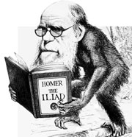
Constructing a Thesis
That is Grounded in
New Critical & Deconstructive
Theory

Slide 2
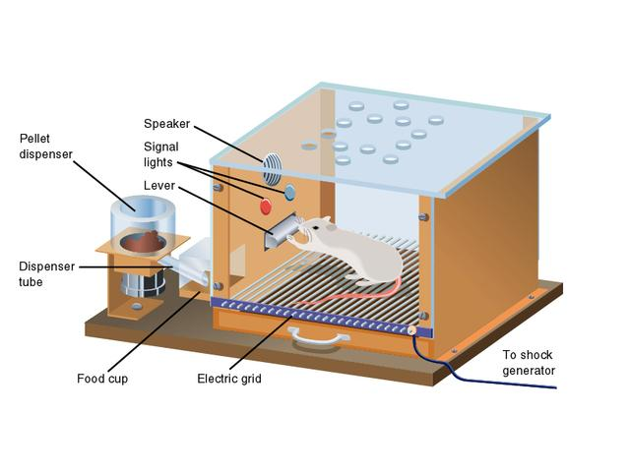
Brief Overview of Skinner’s “Zap”
http://www.youtube.com/watch?v=cl7jr9EVcjI

Slide 3
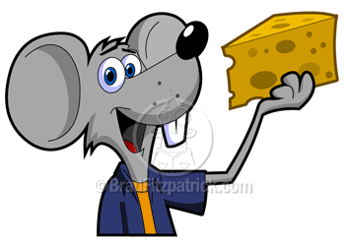
Thesis: Student Sample
In the vignette “The Littlest Hitler,” Ryan Boudinot constructs an inverted historical binary in order to demonstrate the dichotomous relationship between two young children and their antithetical dispositions. As the story progresses, multiple circumstances of irony, paradox, and syntactic ambiguity arise, further enhancing the diametric personalities of Davy and Lisette, costumed as Adolf Hitler and Anne Frank respectively.

Slide 4
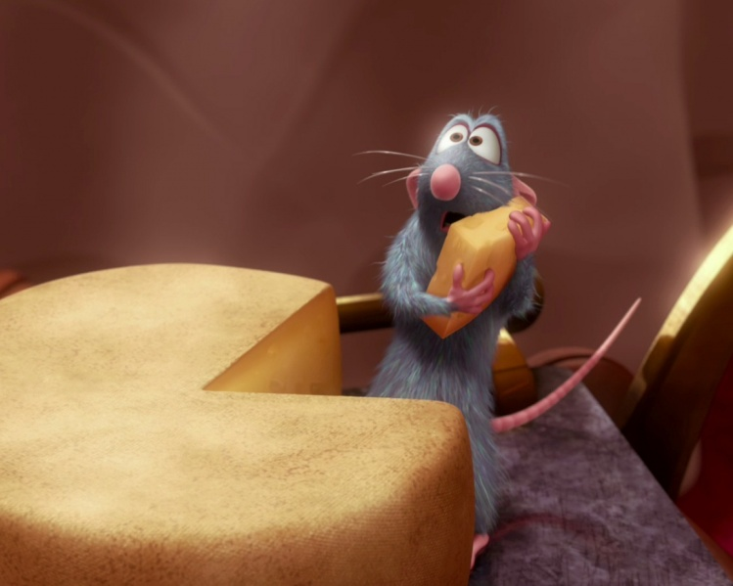
Follow the Pattern to the Cheese
“Visiting Hours” by Judy Budnitz uses binary inversion and juxtaposition to uncover the truth behind Ezra and his family's past. The concise diction and dichotomy between fiction and reality revealed the truth about his abusive father.

Slide 5
Student Sample: Right to the Cheese!!
In his vignette “The Littlest Hitler,” Ryan Boudinot combines a historical binary with an inversion of expected roles to convey that people are not always what they appear to be. The story is set on Halloween, a day of pretending and being something different; however, ironically the characters fail to take on the roles of their costumes and instead act themselves. The use of a binary inversion helps the reader understand the paradoxical relationship between a person and their Halloween costume, as well as the irony pretending to be someone else entails.

Slide 6
Student Sample: Avoid the “Zaps”
In the story “Us and Them” by David Sedaris, the author uses both diction and syntax to de-humanize the child he was and also to separate himself, as the adult, from the negative implication that is associated with the young David’s greed. He does this because he wants to connect himself to the bad aspects of his own personality as little as possible. If you juxtapose the scene where Sedaris is frantically devouring his Halloween candy with his face covered in chocolate, along side the place in the story where he blames his mother for his own not making friends, you can really see how much he tries to avoid connecting his adult self with the negative parts of his own life.

Slide 7
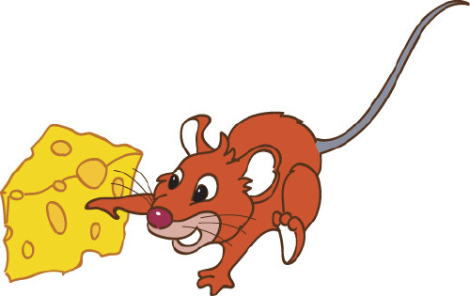
Student Sample: Go Get the Cheese!!
The story “Littlest Hitler” uses literary elements such as dichotomy, binary, irony, and juxtaposition to establish a character throughout the text. Specifically, historical binary is used when describing the traits of a boy dressed as Hitler and a girl dressed as Anne Frank. This, and other things like it, helps show the innocence of childhood as compared with what the world forces onto children (the evils of Hitler, hookers, etc.).

