Slide 1
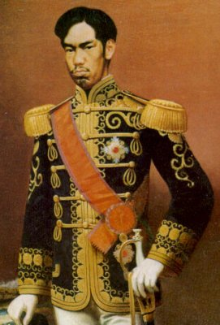
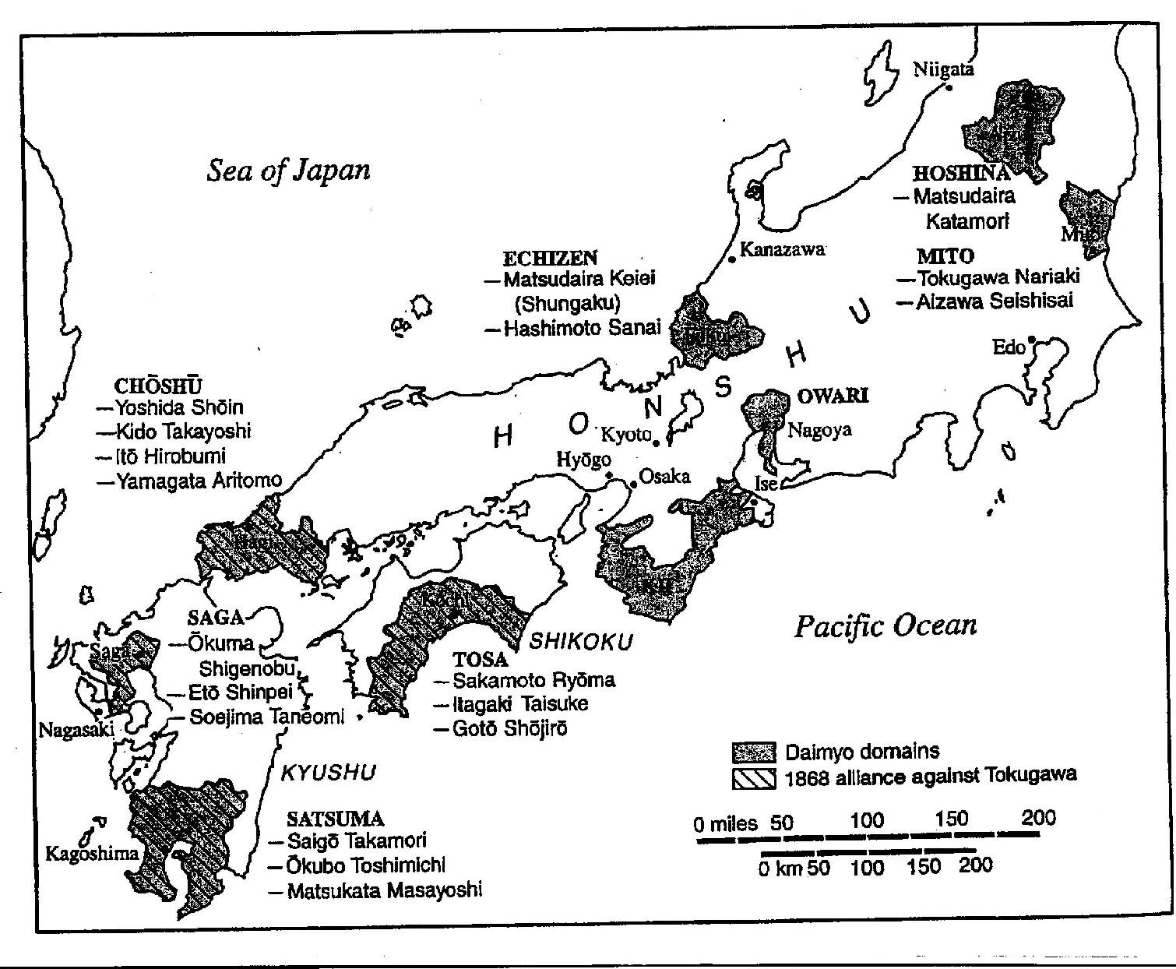
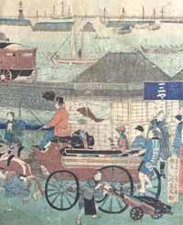
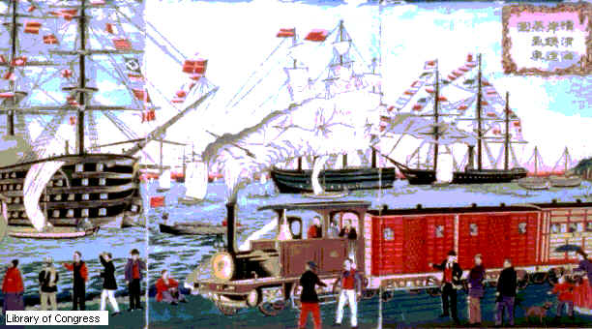
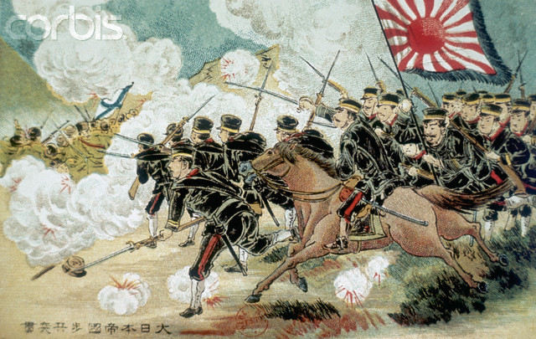
The Meiji Emperor & Modernization of Japan
The Treaty of Kanagawa
The Sino-Japanese War
The Russo-Japanese War

Slide 2
Japan Ends its Isolation
In 1635 Japan had issued a formal declaration from the Shogun declaring Japan closed to contact with the outside world (*under penalty of death!)
Japan only traded during this period with the Dutch & Portguese & only through the port of Nagasaki
In 1853 the United States sent a fleet of warships under the command of Commodore Matthew C. Perry at the urging of President Fillmore
Perry’s goal was to open Japan to trade with the US, something no other country had been able to do
In 1854 Japan signed the Treaty of Kanagawa (Treaty of Friendship) with the United States, formally opening a trade relationship & exchange of ambassadors
Japan very quickly sent out students to all Western nations, including the US, in order to study western ways and technology

Slide 3
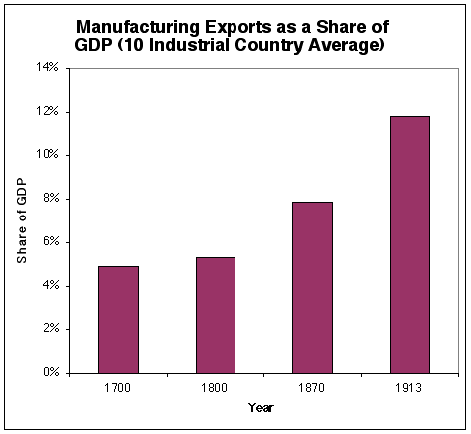
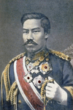
Japan Modernizes
Under the leadership of Emperor Mutsuhito Japan entered a period of modernization known as the “Meiji Period”
The emperor became known as “The Enlightened One”(Meiji) due to his ability to realize that Japan needed to become a modern nation in order to stand up to the Imperialist powers of the US & Western Europe
Japan very quickly began to modernize its factories, economy, military, education system, & government
By 1872 Japan had built its first 20 miles of railroad; this grew to over 7000 miles by 1914
Japan’s coal output also grew from ½ million tons in 1875 to over 21 million tons in 1913
Japan’s government supported factory owners by giving them loans and many of the former samurai became business owners and heads of the new zaibatsu *(Japanese corporations)
Silk & tea production became important exports helping to fund Japanese economic expansion
By 1890 Japan had an army of over 500,000 men; Japan began to assert itself in Asia by increasing its trade & military presence in the region

Slide 4
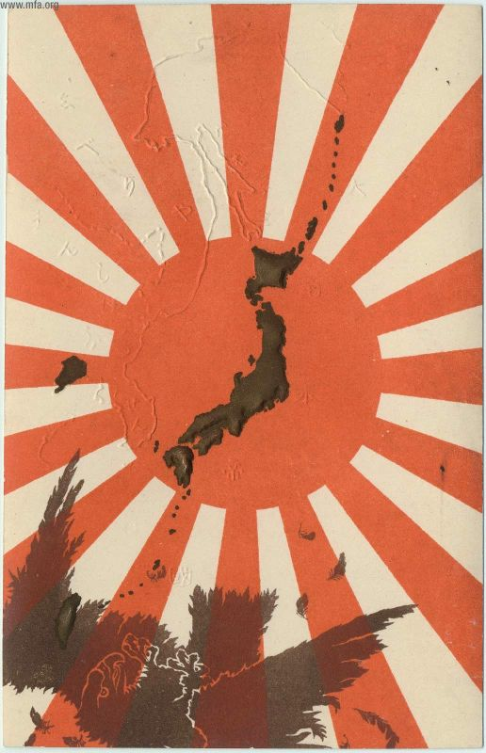
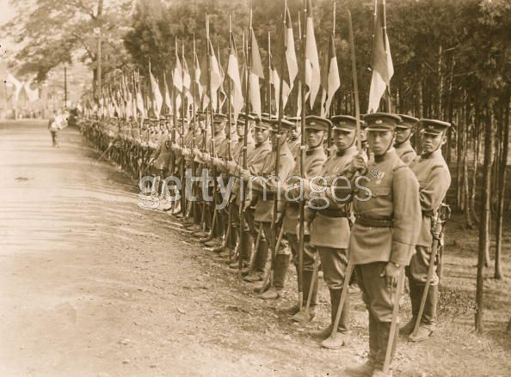
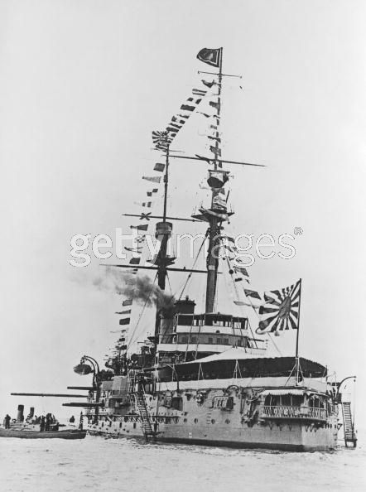
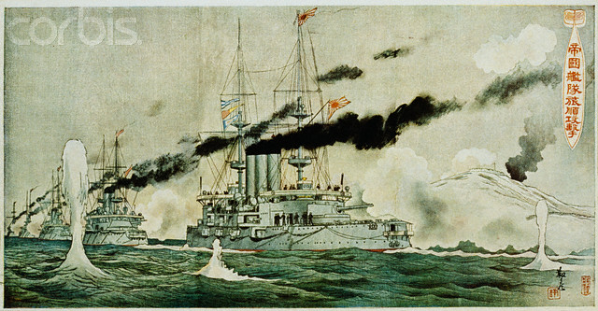
Japan Becomes an Imperialist Power
In 1894 Japan revoked the extraterritorial rights of the Western foreign powers and began to act with extreme pride in its accomplishments (Nationalism)
In 1876 Japan had forced Korea to open 3 ports to trade, but, China also had interests in Korea
In 1855 both Japan and China signed an agreement regarding their interests in Korea
In June 1894 China broke the agreement by marching troops into Korea to put down a rebellion; Japan saw this as an act of war and declared war on China (The first Sino-Japanese War)
Japan had defeated China in the 1st Sino-Japanese War in 1895 and had taken control of the Korean Peninsula as well as Taiwan (Formosa)
Russia wanted to annex Korea in order to have an ice-free port on the Pacific but Japan viewed either Chinese or Russian control over Korea as “A dagger pointed at the heart of Japan”

Slide 5
Port Arthur: Surprise Attack
Japan launched a surprise attack against Russian ships anchored at Port Arthur off the Korean coast (Feb.1904)
Japan simultaneously attacked Russian troops in Korea at the Battle of Mukden
The naval assault was successful with the entire Pacific Fleet of Russia either captured or sunk
Ground warfare would last the duration of the war (until the Treaty of Portsmouth in 1905)

Slide 6
Japan as an Imperialist Nation
What does this cartoon show about Japanese expansion in the Pacific?
What future actions does it predict that Japan may take?

Slide 7
Japan Wins the Russo-Japanese War & the Settlement of the War

Slide 8
Mapping the Settlement

